Slide 1



Social media posts - slide instructions
These slides have been designed for you to alter with information you wish to share,
then export and upload to social media.
Slide four is designed for text.
Slide six is for text and images.
Slide eight is for images alone.
Example slides
Slide 3
Slide 5
Slide 7

Slide 2
Exporting slides
Once you are happy with your slides you need to Export as a jpg.
  Go to File > Export…
  In the drop-down menu under File Format select JPEG.
  Once selected, a menu will pop up. You can choose to save the slide you are currently on,
  or all the slides in the PowerPoint.
  Next, select where you would like to save the JPEG.
  You will now have a JPEG of your slide to post online.

Slide 3
Text slide instructions
This page has been provided to help produce a text post, using slide four.
Place your text in text box in the center of the slide.
Be sure to use Myriad Pro font in white.
Resize the text so that it fits the slide nicely.
Once you are happy with your slide, follow the ‘Exporting slides’ instructions (on slide two of this PowerPoint presentation).

Slide 4

”Accurate assessment of donor and recipient immune compatibility is undertaken by specialist histocompatibility and immunogenetics scientists is essential for safe and successful heart transplants.”
Ann-Margaret Little
Consultant Clinical Scientist, Honorary Clinical Senior Lecturer In Histocompatibility and Immunogenetics

Slide 5
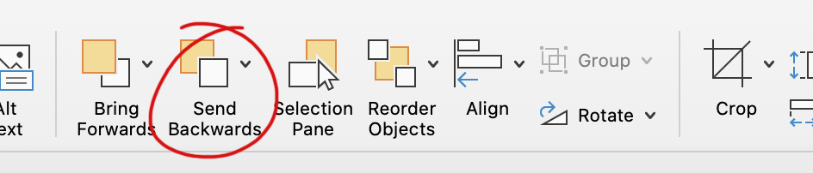
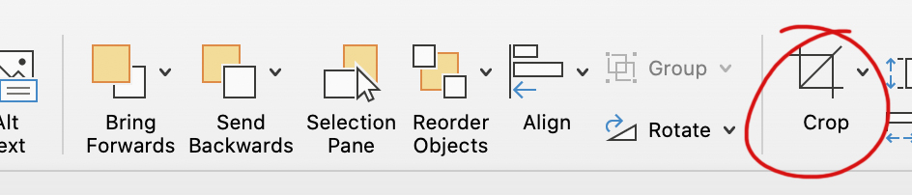
Image and text slide instructions
Below are some steps to help you produce your post using slide six.
Place your text in text box on the left of the slide.
Be sure to use Myriad Pro font in white.
Resize the text so that it fits the slide nicely.
Delete the ‘Image Here’ text box.
Place your image on the slide so it fills the space on the right. Portrait images work best.
Once you have placed your image, head to the Picture Format tab, as shown below.
We need to send the picture to the back. Click Send Backwards until it is behind the text box.
Here you can also Crop the image so it fits the space nicely.
Once you’re happy with your slide, follow the ‘Exporting slides’ instructions (on slide 2 of this PowerPoint presentation).

Slide 6


”Accurate assessment of donor and recipient immune compatibility is undertaken by specialist histocompatibility and immunogenetics scientists is essential for safe and successful heart transplants.”
Ann-Margaret Little
Consultant Clinical Scientist, Honorary Clinical Senior Lecturer In Histocompatibility and Immunogenetics

Slide 7
Image slide instructions
This page has been provided to help produce an image post, using slide eight.
Drag and drop the image you wish to share onto the slide. Landscape images work best.
Once you have placed your image, head to the Picture Format tab as below.
Click Send Backwards until your image is behind the RCPath logo box.
Here you can also Crop the image.
Crop the image and move it within the frame until it fits the space nicely.
Once you’re happy with your slide, follow the instructions on ‘Exporting slides’ (on slide 2 of this PowerPoint presentation).

Slide 8



