Slide 1


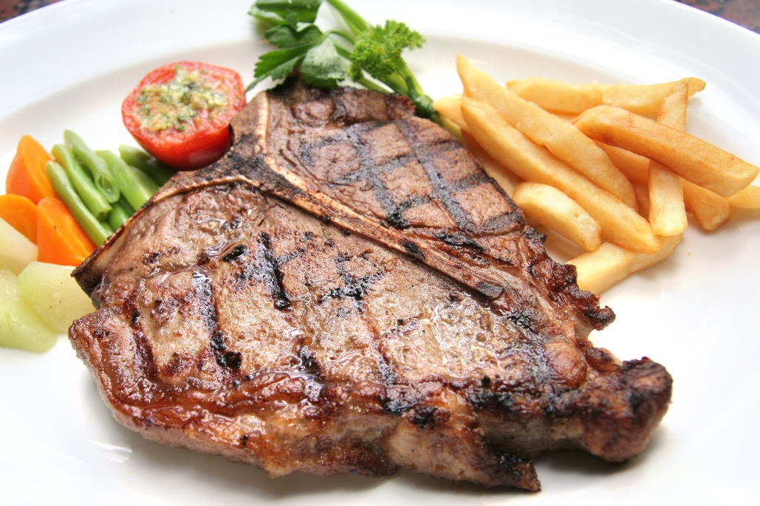
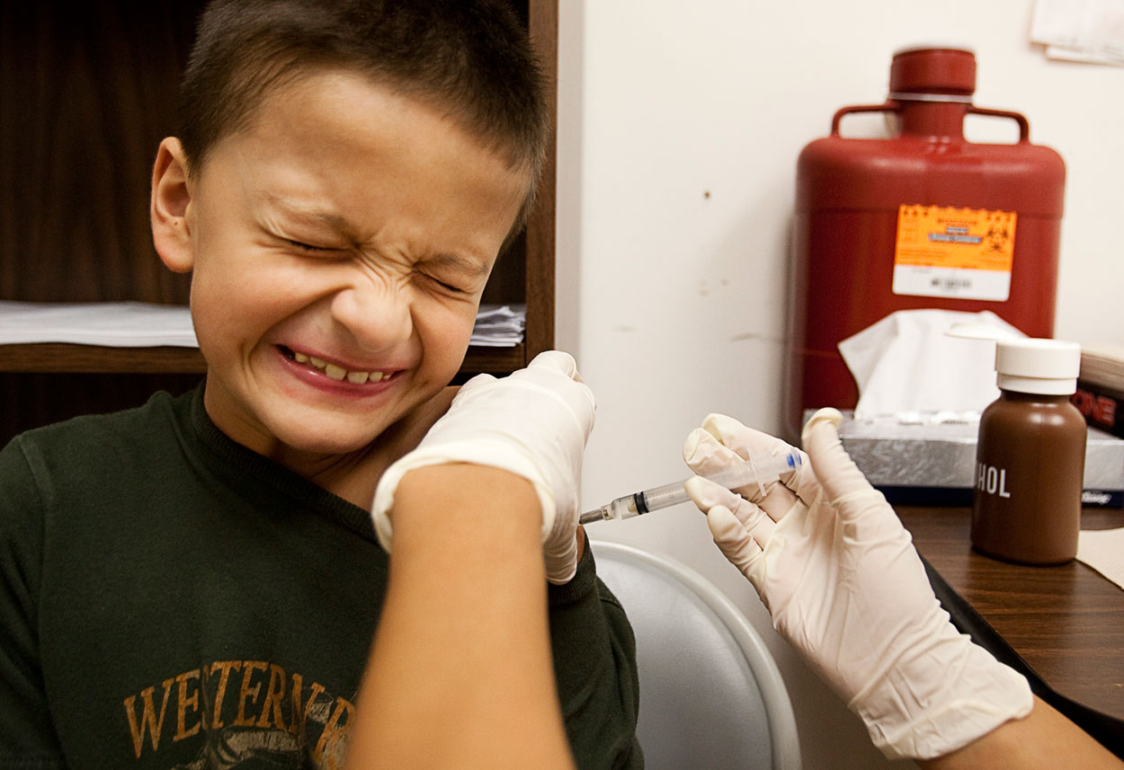

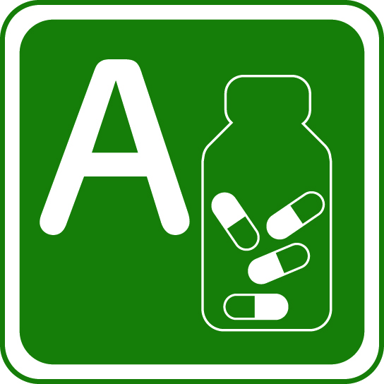

What links the two?

Slide 2
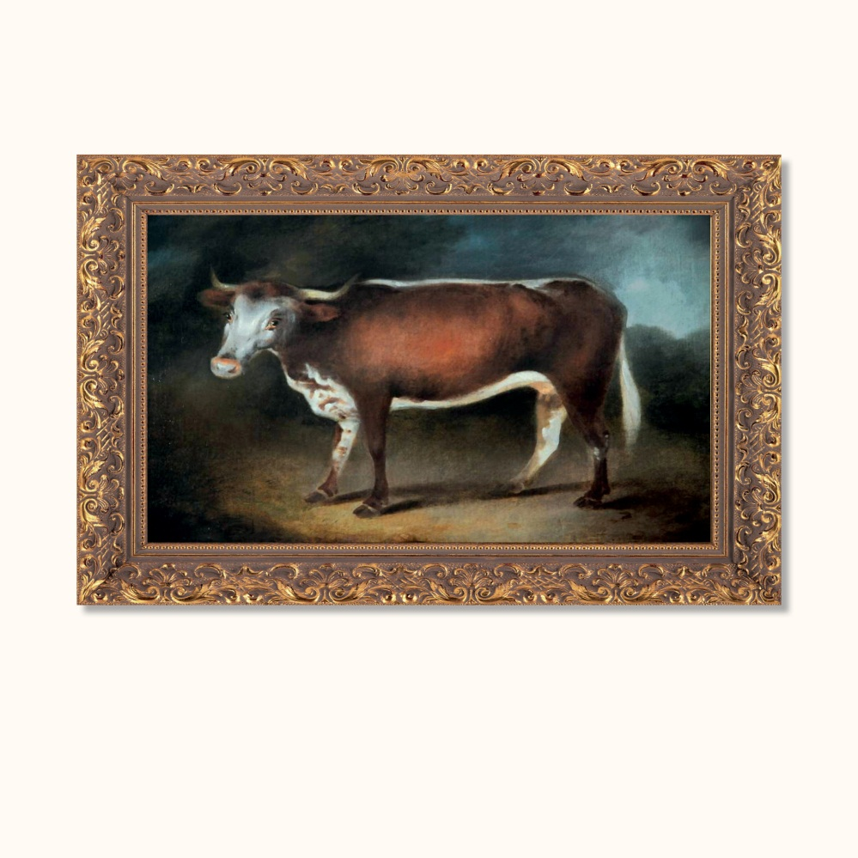
A steak and a boy receiving a vaccine
Blossom the Cow
A Gloucester cow, Blossom is
famous for being the animal used
by Edward Jenner in his
vaccination against smallpox

Slide 3
