Slide 1


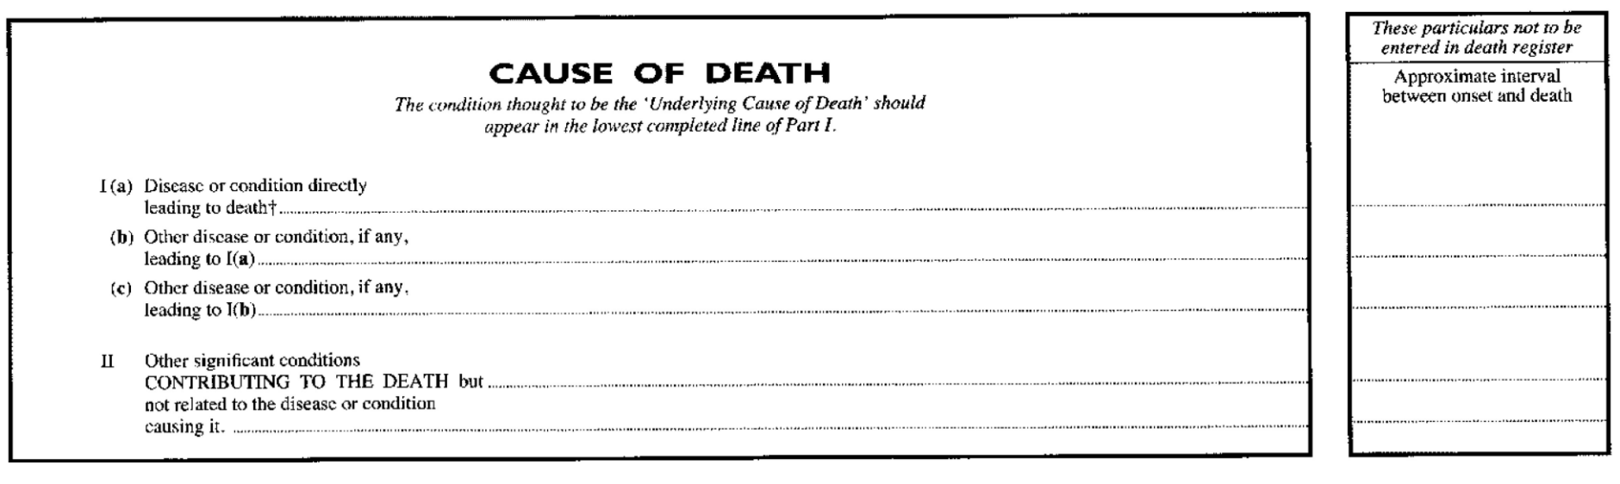
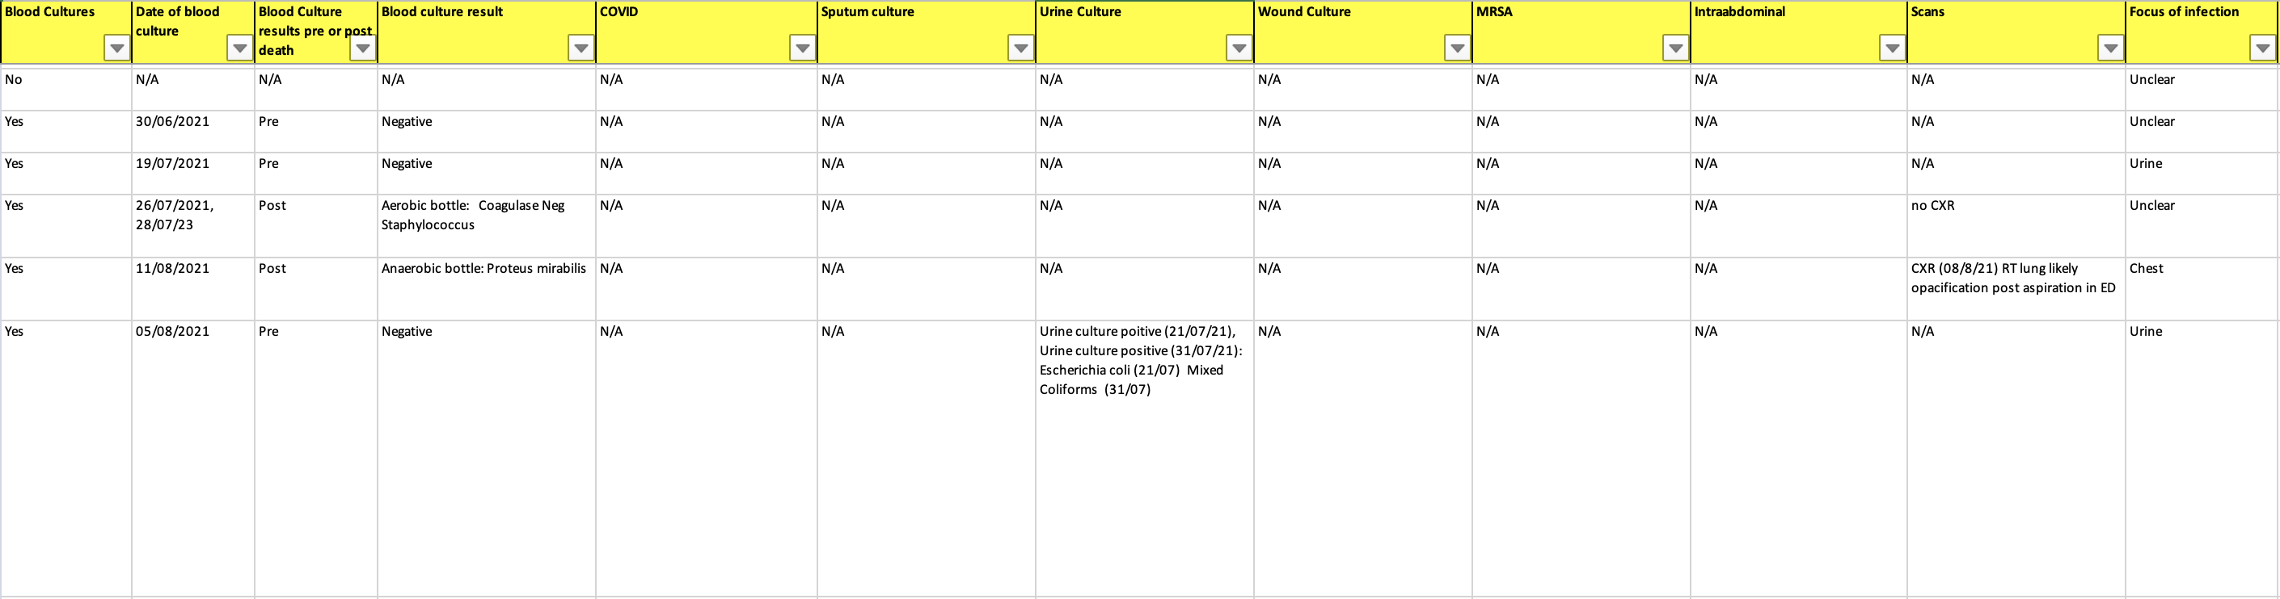
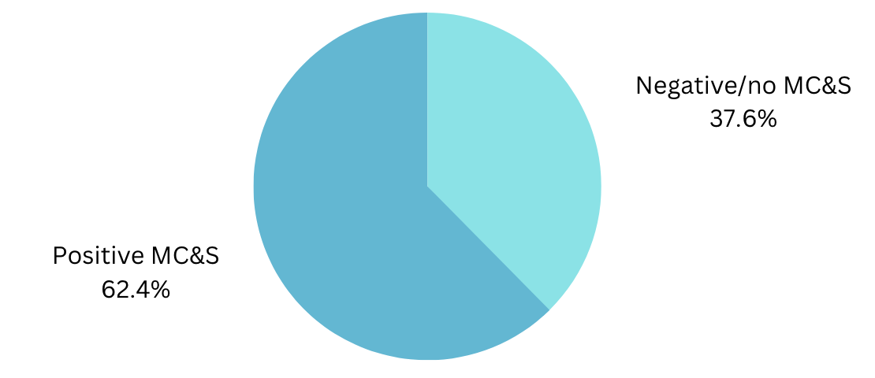
Reviewing the appropriate documentation of sepsis of unknown aetiology on Medical Certificate of Cause of Death - An audit
Abhinithi Nalwad; Daniel Bando
Colchester General Hospital
BACKGROUND
Medical Certificate of Cause of Death (MCCD) should detail causative microorganisms and their antimicrobial resistance (AMR) at a patient’s time of death, if present.
National Medical Examiner’s Good Practice Series No.9 recommends detailing AMR and microorganisms of interest as part of key data to help fight AMR.
WHO identifies AMR as one of the top 10 public health threats facing humanity(1).
AMR reduce the effectiveness of therapies and worsen health outcomes.
MCCDs with “sepsis of unknown aetiology” as cause of death 1(a) were reviewed to see whether the causative organism and resistances are in fact known.
AIM
Identify inaccurate documentation of sepsis of unknown aetiology in cases where causative microorganisms and AMR are present.
Accurate documentation of the above is a key goal in the UK 5-year antimicrobial resistance action plan for medical examiners.
METHOD
93 MCCDs collected from Medical examiner/Medical examiner Officer database with sepsis of unknown aetiology as Cause of Death 1a recorded between January 2021 and December 2022.
Records of microscopy, culture and sensitivity (MC&S) if present during last admission to hospital were reviewed.
In cases where MC&S samples had been taken and no organisms were cultured or where no MC&S samples had been taken before a patient’s death, these were regarded as valid records of “Sepsis of unknown aetiology”.
In cases where MC&S samples were taken and organisms identified and yet the MCCD had recorded “Sepsis of unknown aetiology”, these were regarded as records where the national standard had not been met.
RESULT
From 93 records, 37.6% of the records accurately identified “sepsis of unknown aetiology”. In 62.4% of the records, causative organisms were recorded but the data has not been recorded to MCCDs.
CONCLUSION
Targets regarding accurate MCCD documentation related to microorganisms and AMR have not been met. This is critical to achieve the UK 5-year antimicrobial resistance action plan for Medical Examiners and public health targets.
If extrapolated to other Trusts, this could imply a larger issue that may require further audit and action.
REFERENCES
(No date) Good practice series: Recording antimicrobial resistance on the medical ... Available at: https://www.rcpath.org/resourceLibrary/good-practice-series-recording-antimicrobial-resistance-on-the-medical-certificate-of-cause-of-death.html (Accessed: 22 October 2023).
Antimicrobial resistance (no date) World Health Organization. Available at: https://www.who.int/news-room/fact-sheets/detail/antimicrobial-resistance (Accessed: 22 October 2023).
Department of Health and Social Care (2019) UK 5-Year action plan for antimicrobial resistance 2019 to 2024, GOV.UK. Available at: https://www.gov.uk/government/publications/uk-5-year-action-plan-for-antimicrobial-resistance-2019-to-2024 (Accessed: 22 October 2023).
Guidance for doctors completing medical certificates of cause of death in England and Wales (accessible version) (no date) GOV.UK. Available at: https://www.gov.uk/government/publications/guidance-notes-for-completing-a-medical-certificate-of-cause-of-death/guidance-for-doctors-completing-medical-certificates-of-cause-of-death-in-england-and-wales-accessible-version#:~:text=Doctors%20are%20required%20to%20certify,the%20MCCD%20for%20antemortem%20investigations (Accessed: 22 October 2023).

