Slide 1
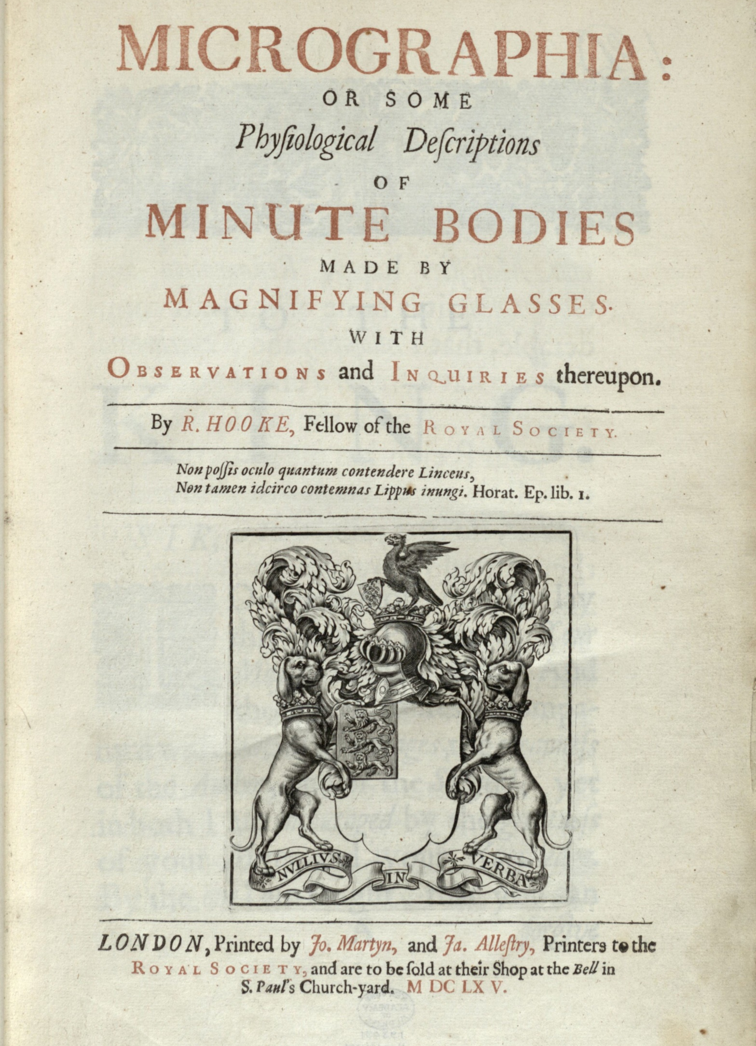

Hooke, Robert, 1665
‘Curator of Experiments
– Royal Society’
Micrographia:
or some physiological descriptions of minute bodies made by magnifying glasses with observations and inquiries thereupon

Slide 2
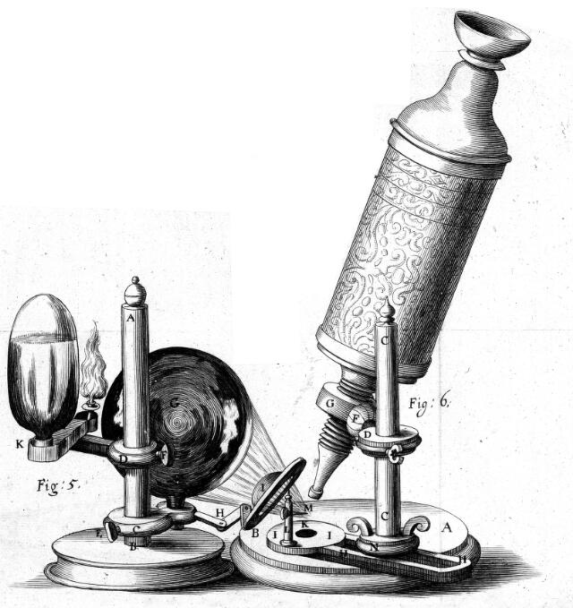
Quiz:
Which of these statements are true about Robert Hooke?
He made his own microscopes & telescopes
Helped re-build London after the Great Fire in 1666
Studied elasticity and has a law named after him
There are no portraits as he didn’t like portraits
2.-12. – Guess what Robert Hooke drew down his microscope/telescope….

Slide 3
Which of these statements are true about Robert Hooke?
He made his own microscopes & telescopes
Helped re-design London after the Great Fire in 1666
Studied elasticity and has a law named after him
There are no portraits as he didn’t like portraits
All true except for IV – Isaac Newton may have been involved in loss of a portrait as they clashed.
2.-12. – Guess what Robert Hooke drew down his microscope/telescope….

Slide 4
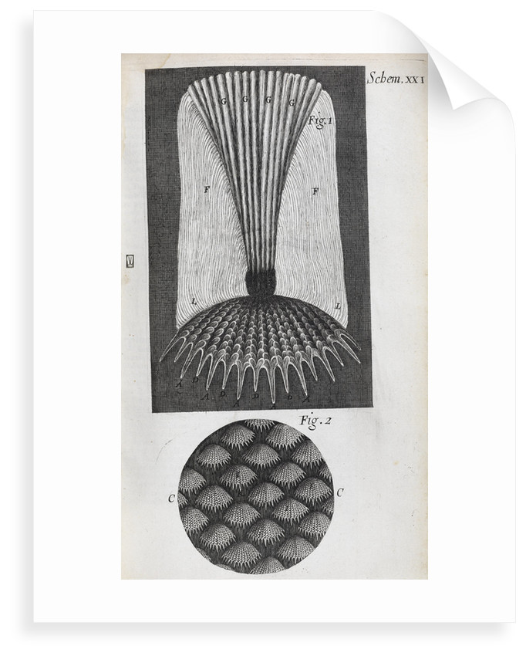
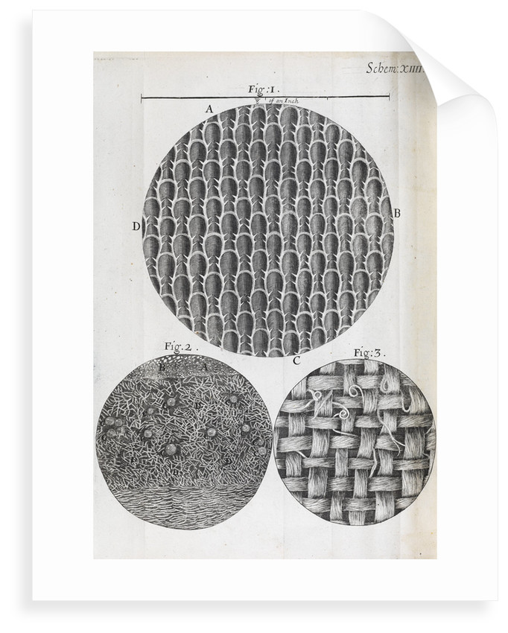
2.
3.

Slide 5
2. Microscope Fish scales
3. Microscope
Views of seaweed and rosemary leaves

Slide 6
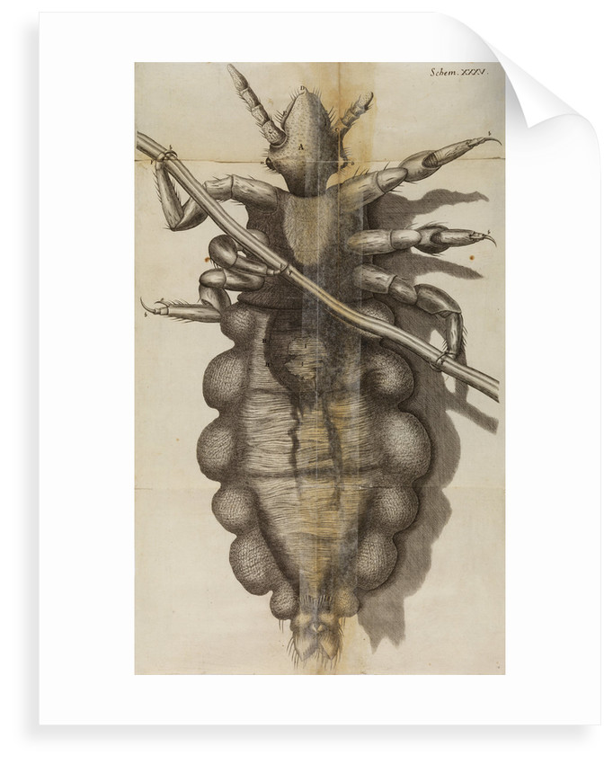
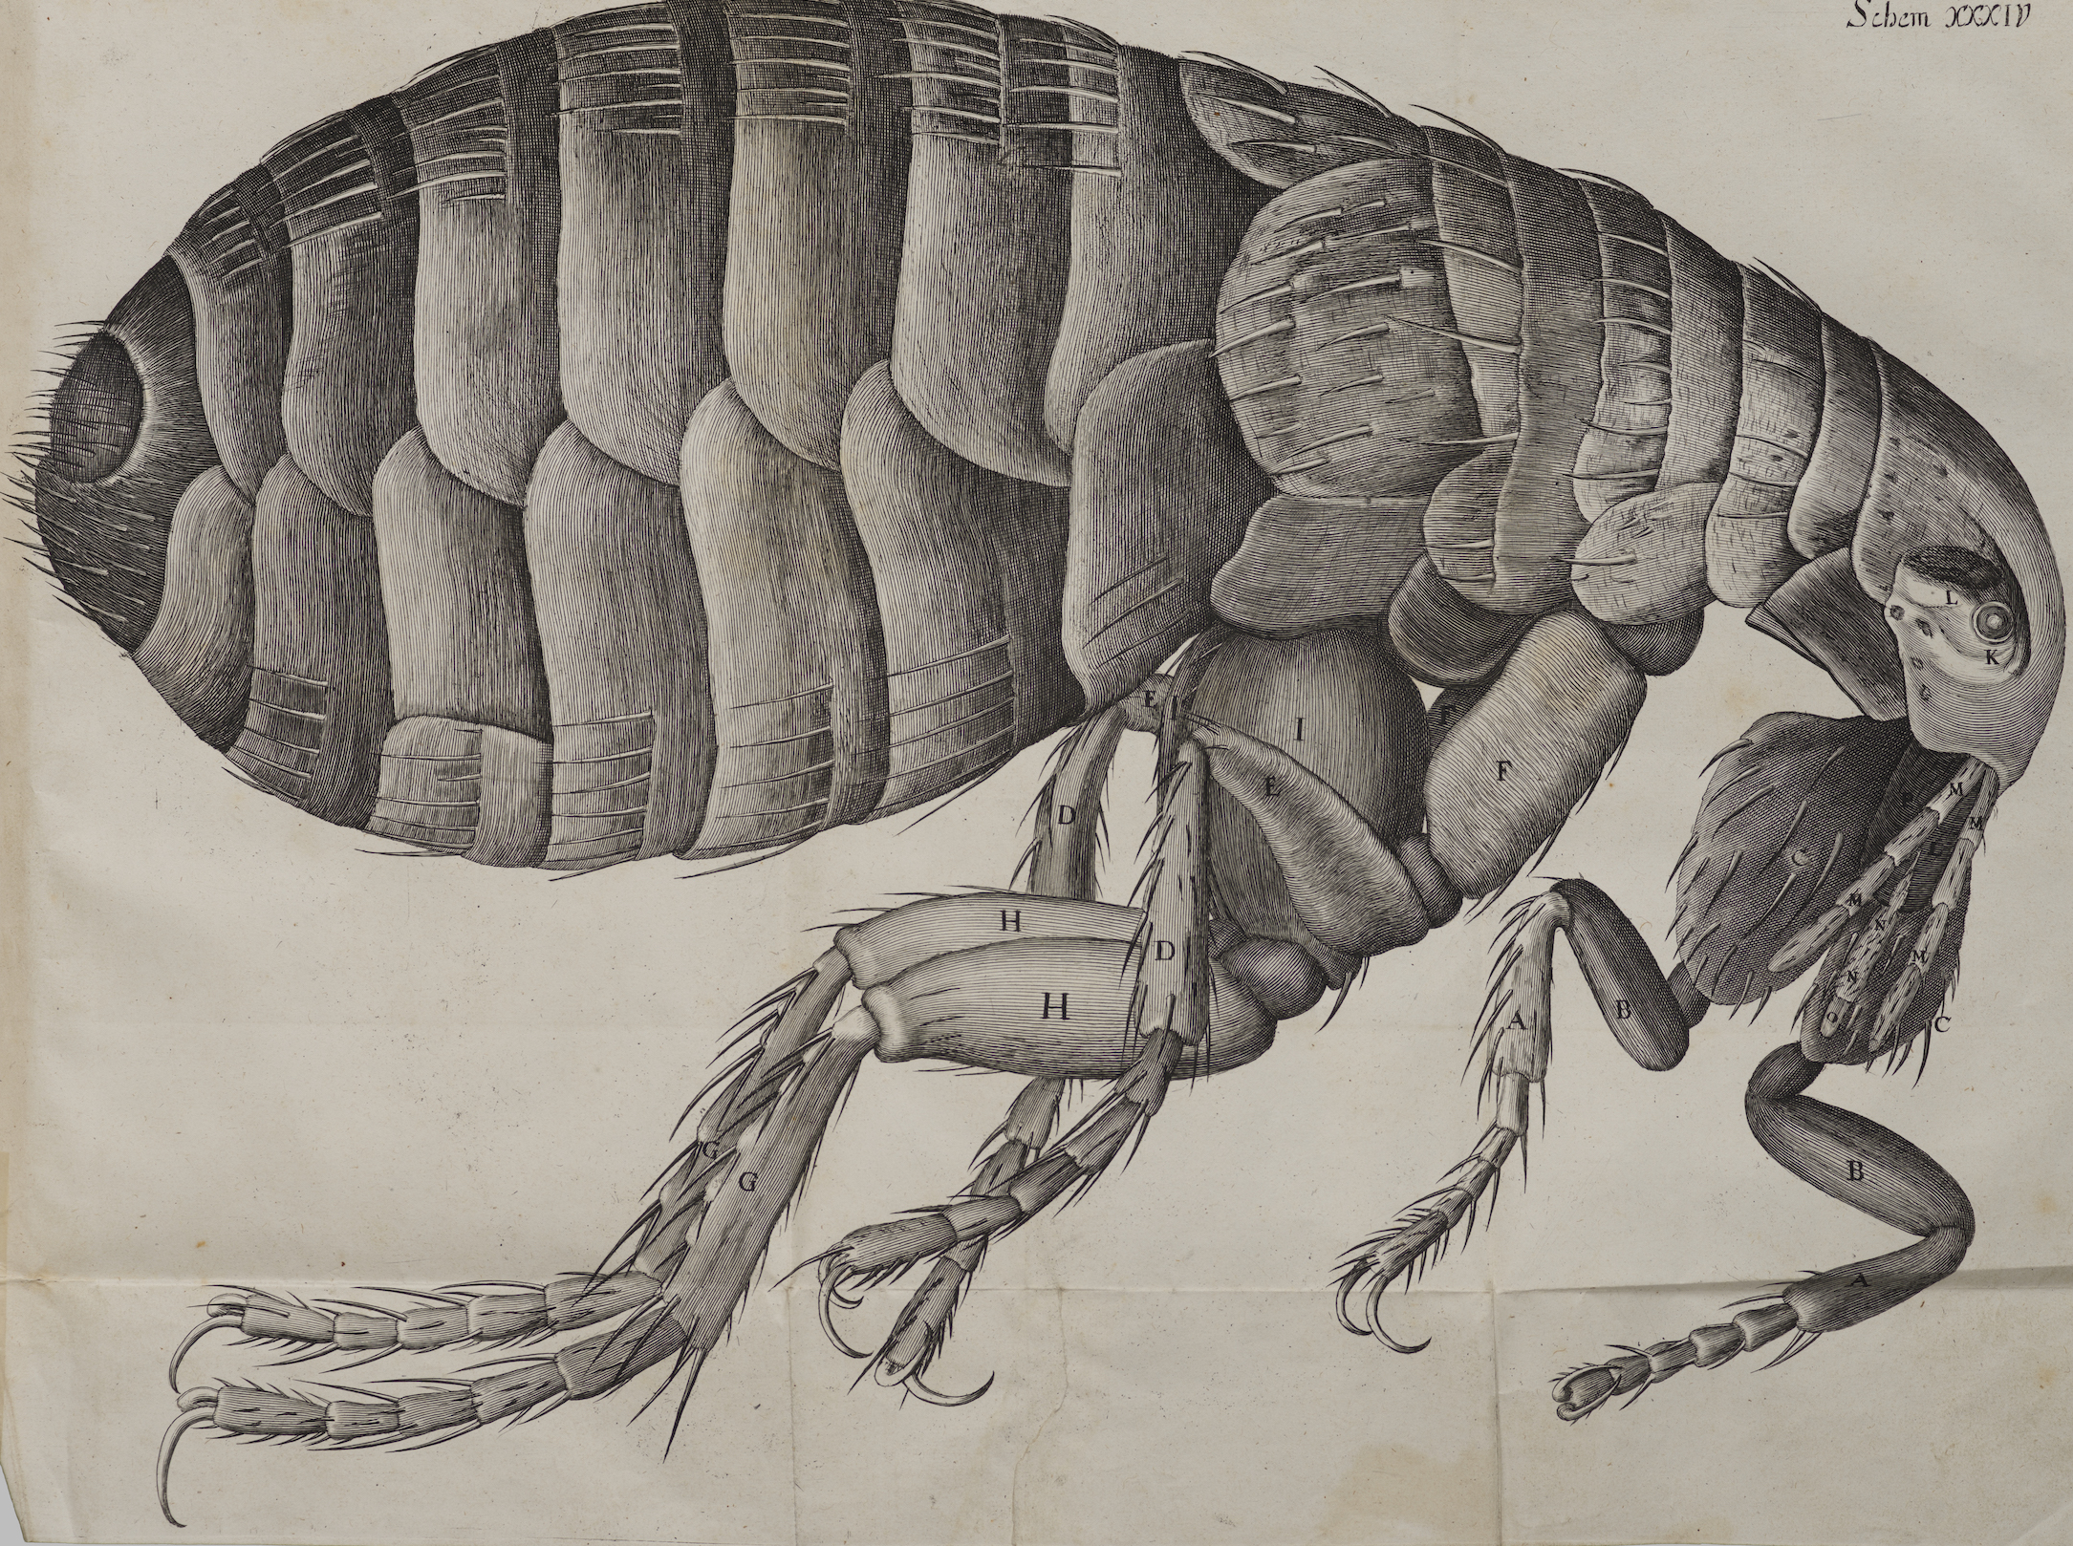
4.
5.

Slide 7
4. Microscope Head louse/nit
5. Microscope Flea

Slide 8
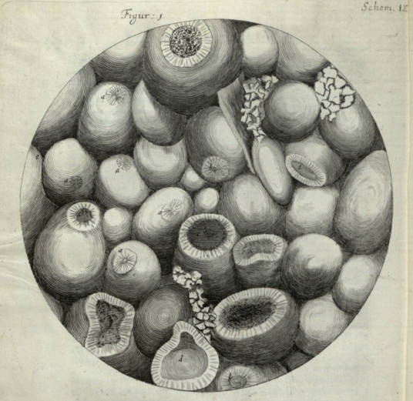
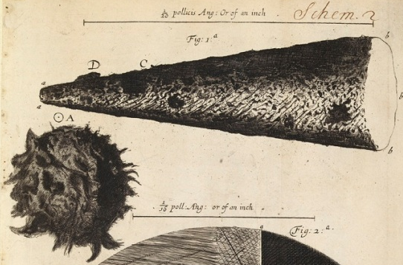
6.
7.

Slide 9
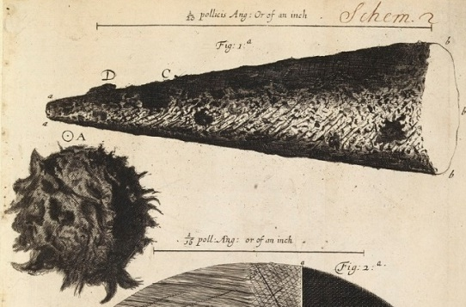
6. Microscope Stone (Kettering)
7. Microscope
Head of a needle & a printed full stop

Slide 10
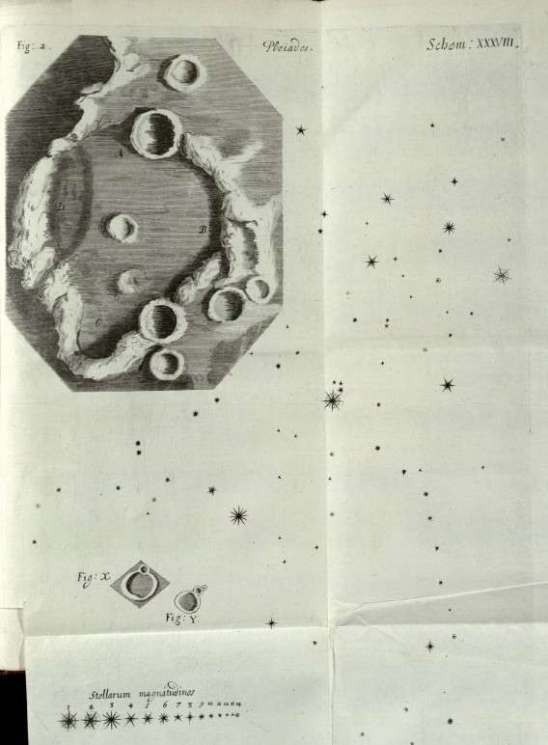
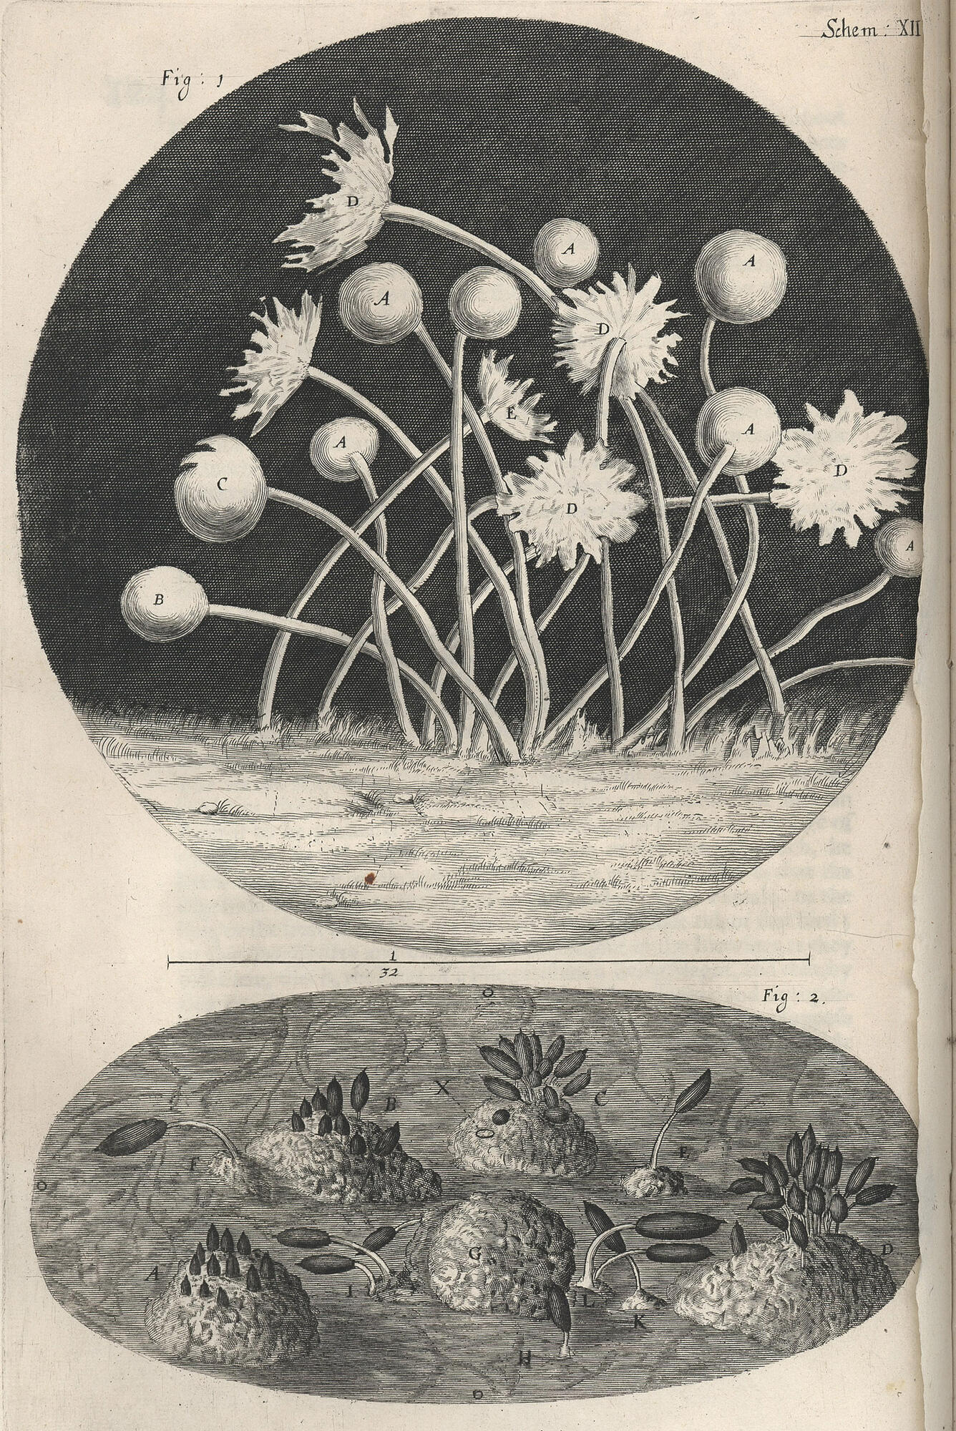
8.
9.

Slide 11
8. Telescope Surface of the moon
9. Microscope Mould on leather
Blight on a rose
(mould)

Slide 12
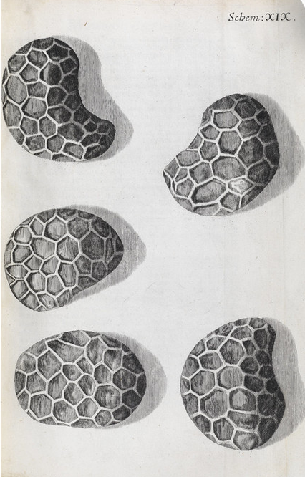
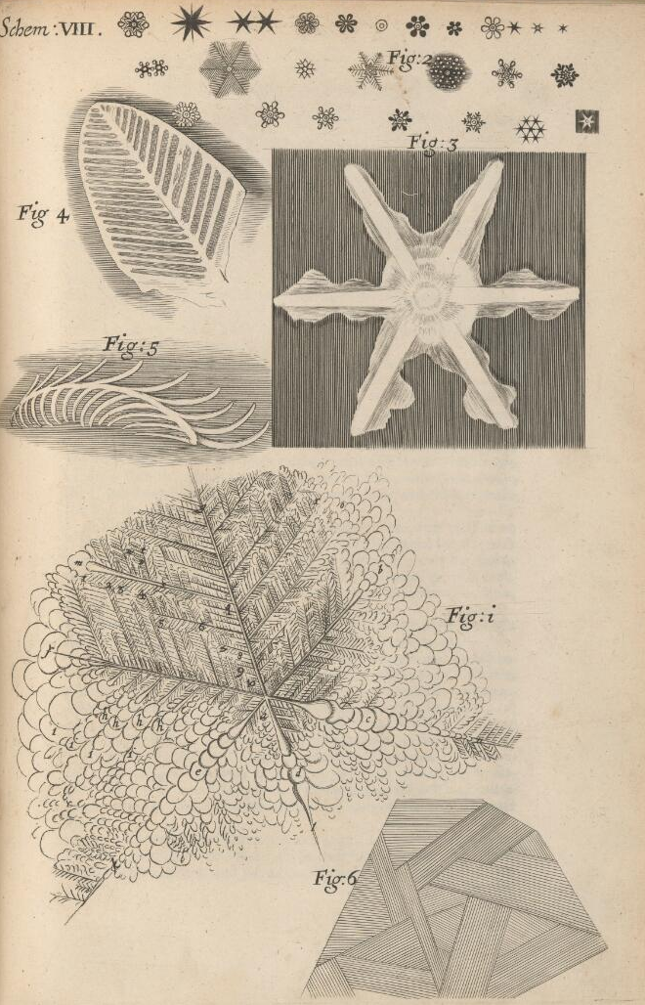
10.
11.
(Three points available)

Slide 13
10. Microscope Poppy seeds
11. Microscope Snowflakes
Ice on marble
Ice on surface
of urine

Slide 14
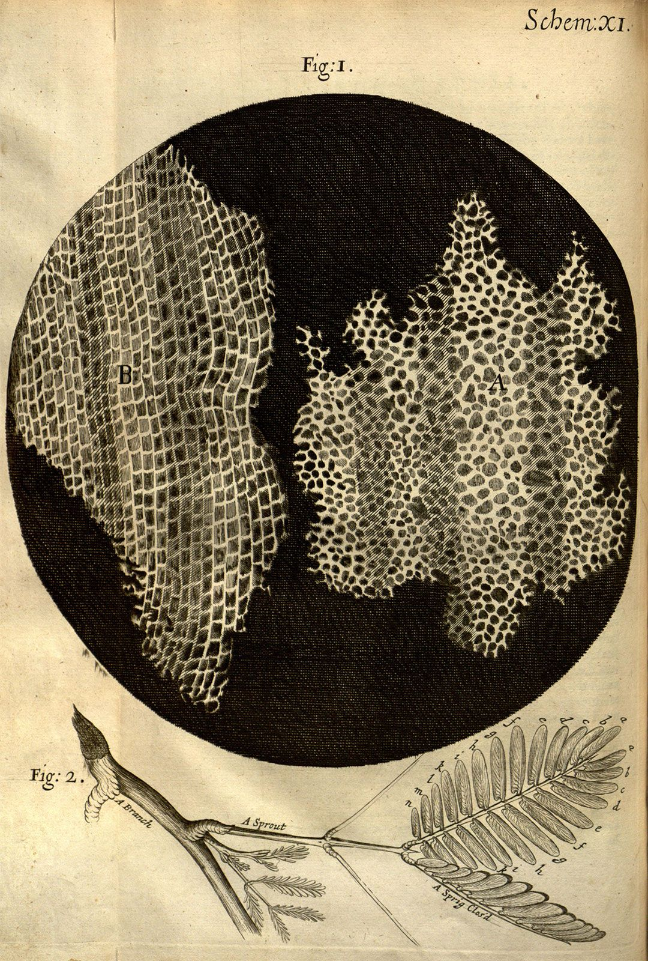
12.

Slide 15
12. Microscope
the first microscopical pores I ever saw, and perhaps, that were ever seen, for I had not met with any Writer or Person, that had made any mention of them before this) but me thought I had with the discovery of them..”
What did Robert Hooke discover?
Hint: Another name for
a little room (in a prison)…
“I took a good clear piece of Cork and with a Pen-knife sharpen'd as keen as a Razor, I cut a piece of it off,.. then examining it very diligently with a Microscope...
constituted of a great many little boxes

Slide 16
12. Microscope
the first microscopical pores I ever saw, and perhaps, that were ever seen, for I had not met with any Writer or Person, that had made any mention of them before this) but me thought I had with the discovery of them..”
What did Robert Hooke discover?
Cells!
“I took a good clear piece of Cork and with a Pen-knife sharpen'd as keen as a Razor, I cut a piece of it off,.. then examining it very diligently with a Microscope...
constituted of a great many little boxes

Slide 17
Micrographia
Take a look down a microscope and make your own observations and inquiries thereupon…
Get drawing!
Find out more: rcpath.org/discoveringcells

