Slide 1

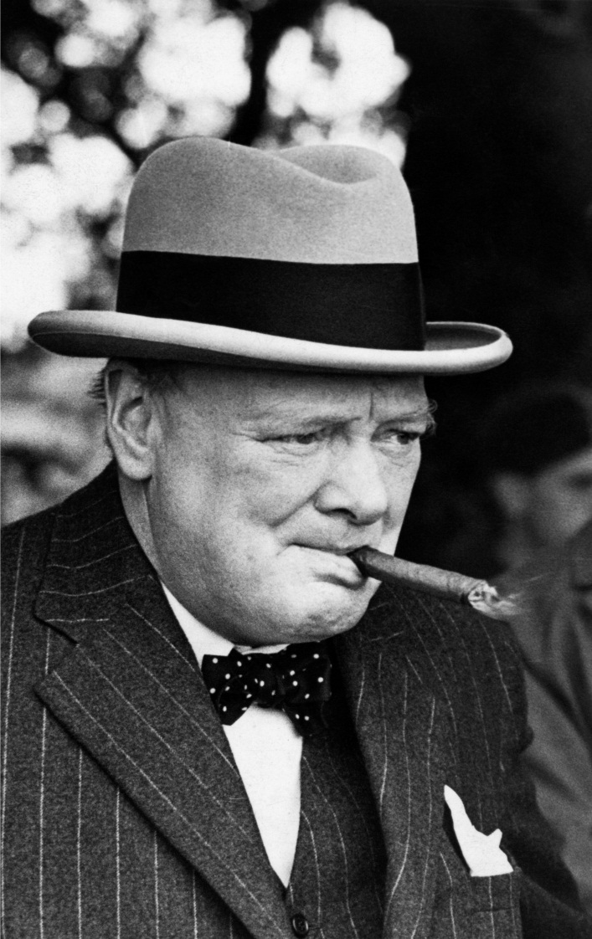
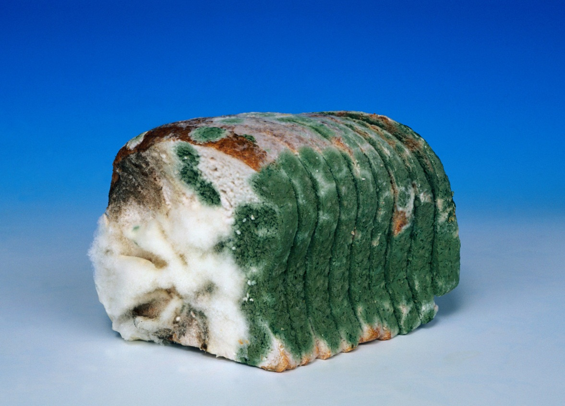


What links the two?

Slide 2
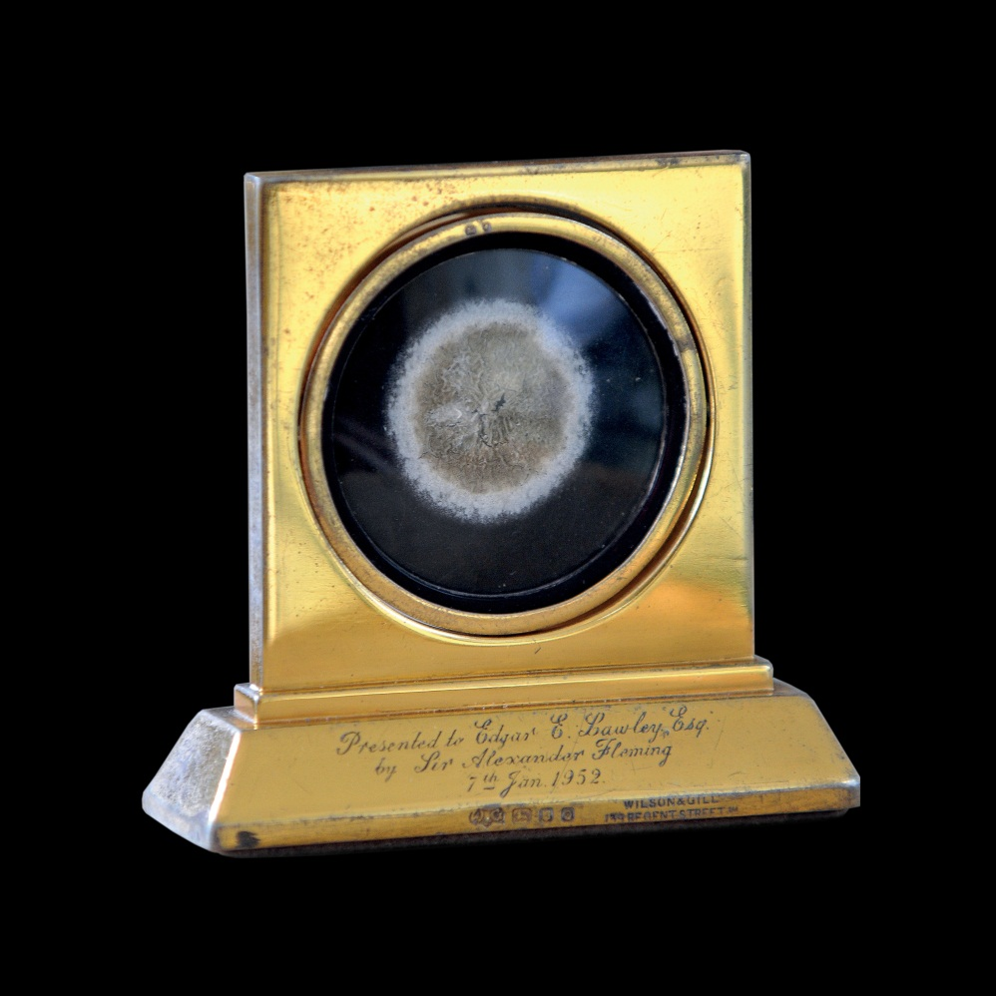
Mouldy bread and Winston Churchill
Penicillium Medallion
Following his discovery of
penicillin, which naturally grows
on mouldy bread, Alexander
Fleming presented mould
medallions to Winston Churchill,
Marlene Dietrich, Pope Pius XII
and others

Slide 3
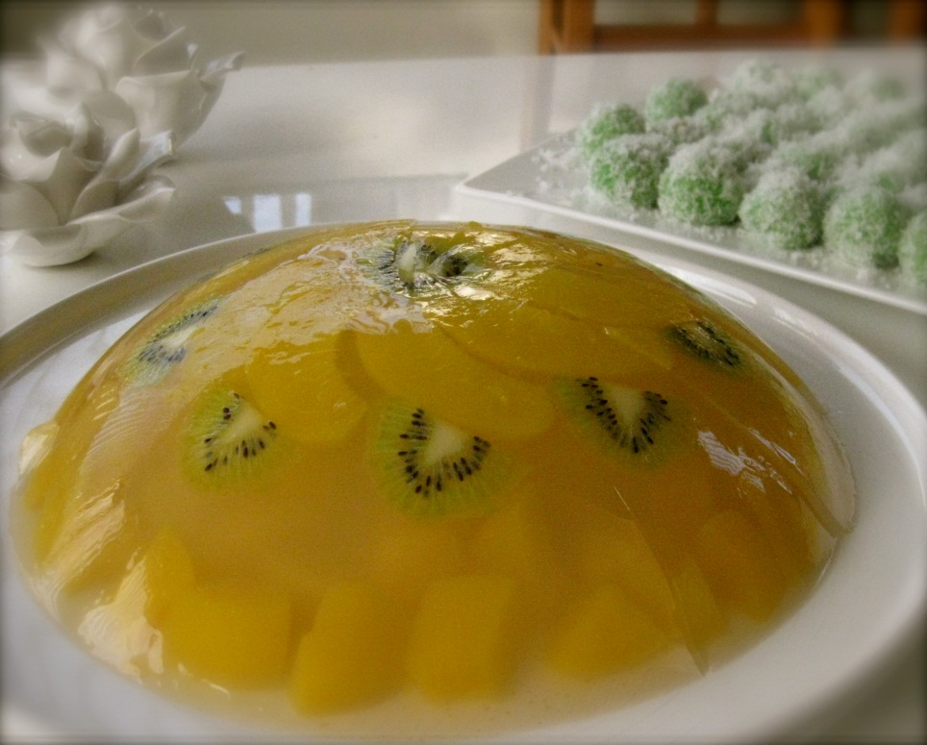
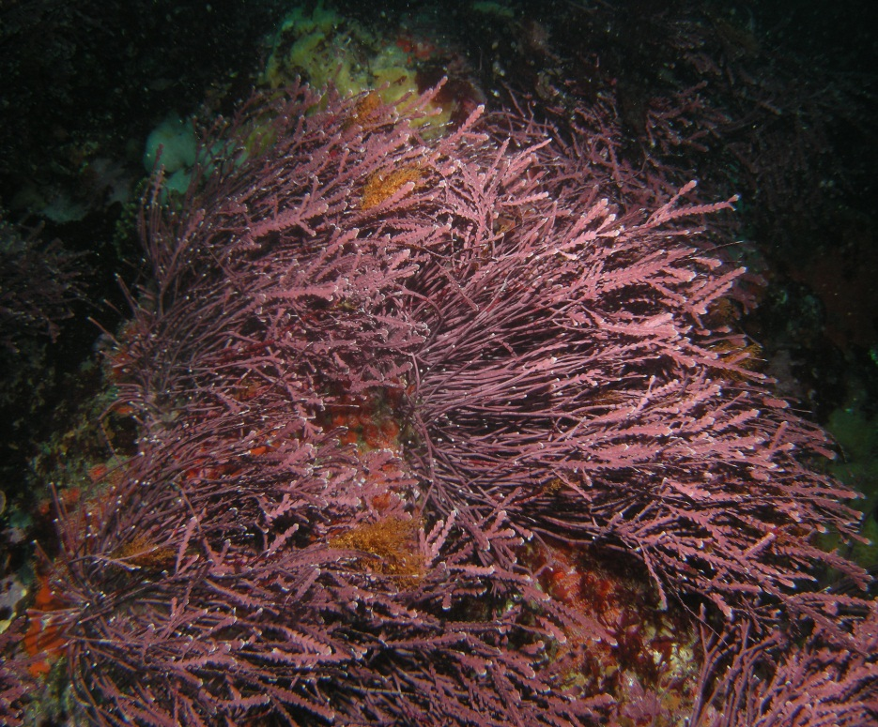

Slide 4
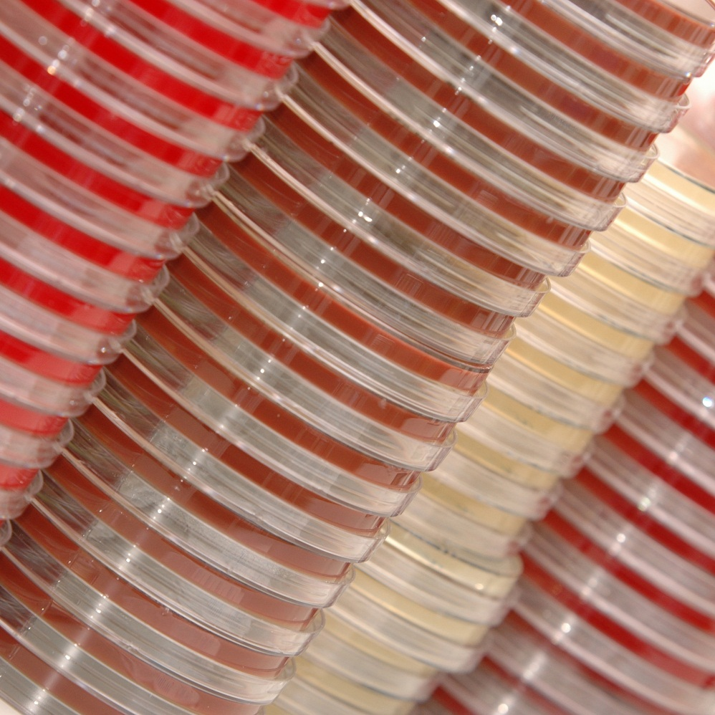
Fruit Jelly and Red Seaweed
Agar Plate
Scientist Fannie Hesse first
suggested using agar as a setting
agent in the lab, having used it in
her own kitchen on hot summer
days. Agar is derived from
Red Seaweed.
Notes:
Activity 4 – if needed

