Slide 1
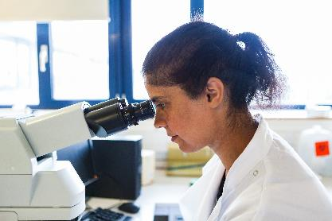
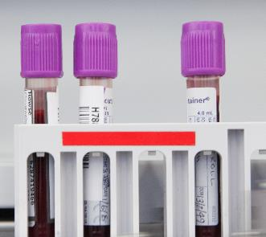

Pathology is the study of disease
.Prevention
Diagnosis
Treatment
Around of 70% of diagnoses rely on pathologists...
Pathologists…
Doctors, vets and dentists with specialist laboratory training, and scientists with specialist clinical training
All work in one of 17 pathology specialties.. These include immunology, veterinary pathology and neuropathology
Most work in one of the ‘Big 4’: histopathology, haematology, medical microbiology and clinical biochemistry. Only 1% work in forensic pathology.
Notes:
Pathology is involved in approximately 70% of diagnoses... That equates to around 14 pathology tests for every person the country per year.
Who had a pathology test such as a blood test in the last year? Why do you think the average is 14 tests per person per year?
Pathology is very diverse in terms of the areas of human and animal health it covers – there re 17 specialties in total. So in addition to the ‘big 4 specialties’ I have talked about, there are 13 other specialties including immunology, veterinary pathology and neuropathology.
Add the personal touch and maybe talk about why what you do is so valuable here

