Slide 1

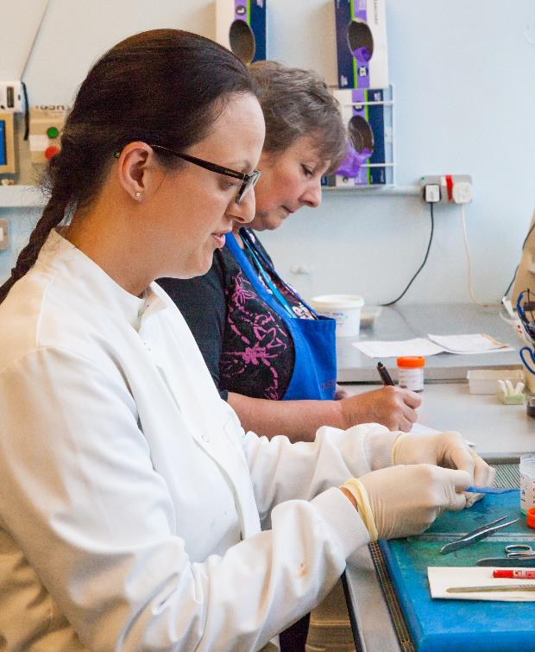
Good attention to detail and an eye for patterns in images or data
Being able to make decisions under pressure
Communication and interpersonal skills
Being able to work as part of a team
Patience and persistence
Core skills for pathologists
Notes:
A good attention to detail for examining tissue to make diagnoses. Many diseases look very similar so being able to spot small differences will help choose the right answer. Being able to work under pressure as you may be given a frozen section to test while a patient is having an operation. This involves freezing a piece of tissue and looking at thin slices under the microscope while the surgeon, and the patient, wait for your answer. The next step of the operation depends on what you find. Histopathologists spend most of their time working with living people so need good communication skills to be able to explain the results of their investigations. Histopathologists work as part of a team with a wide range of health professionals including other doctors, scientists, nurses, dieticians and secretarial staff.

Slide 2
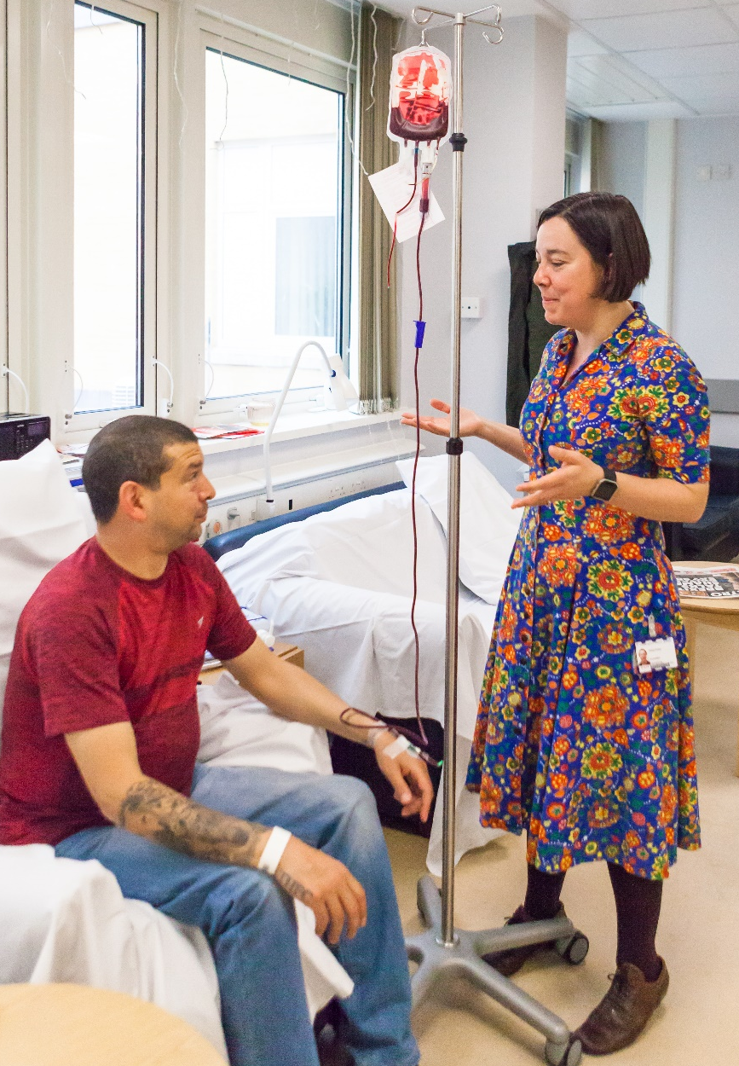
Building relationships with patients
Managing long-term care of patients
Interest in working with patients on ward rounds and in out-patient clinics
Aptitudes for patient-facing specialties
Notes:
When we asked haematologists what skills are important to work in their specialty inter-personal skills and empathy were highlighted, as were good interpretative skills.

