Slide 1

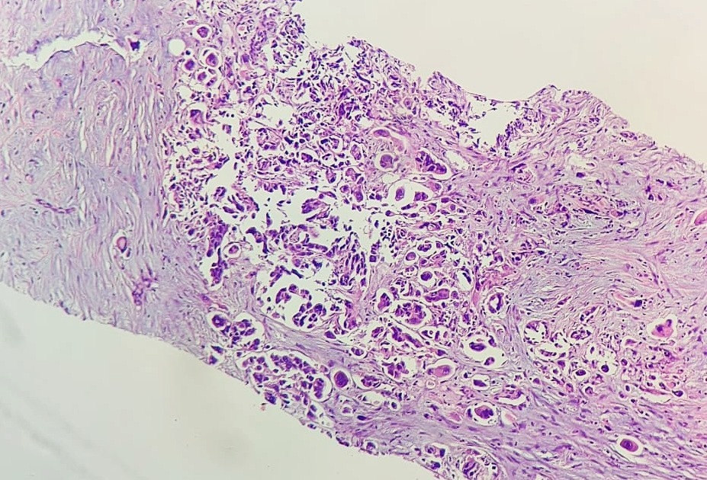
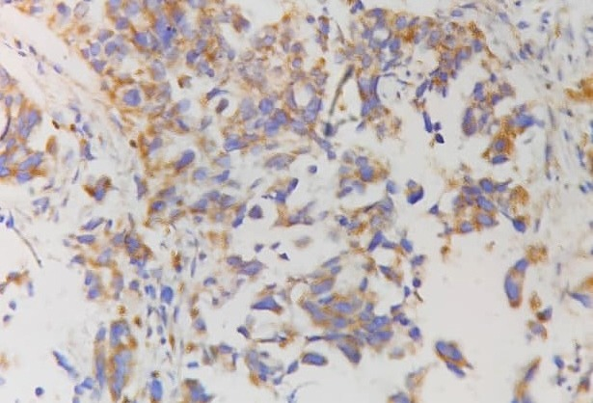
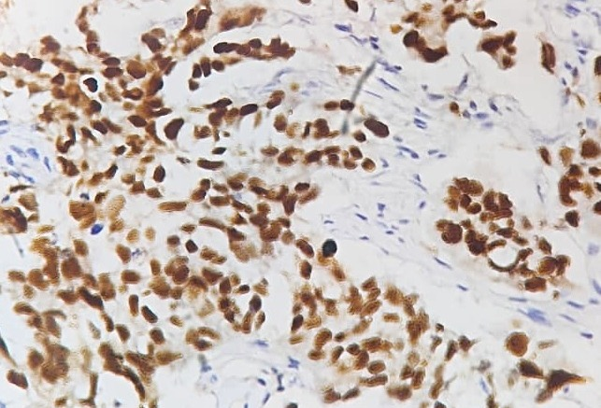
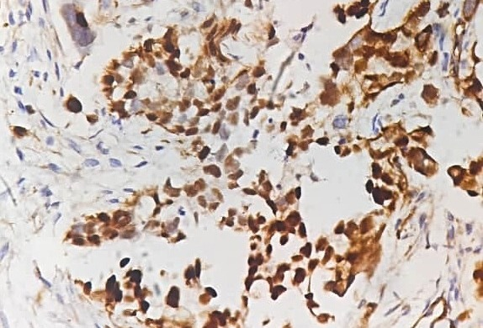
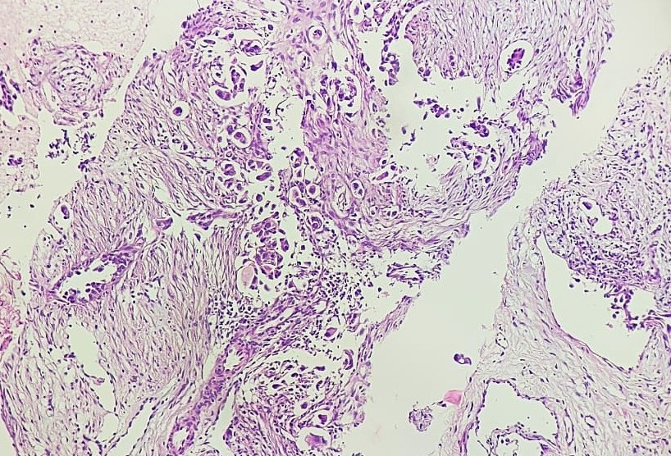
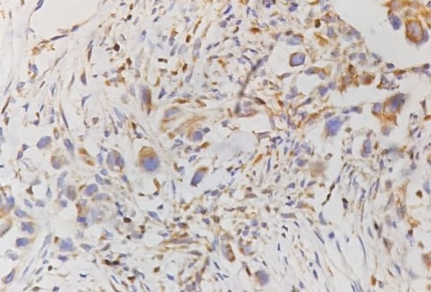
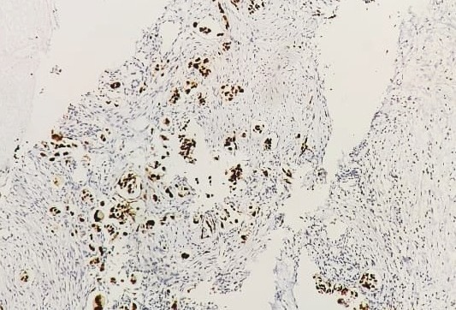
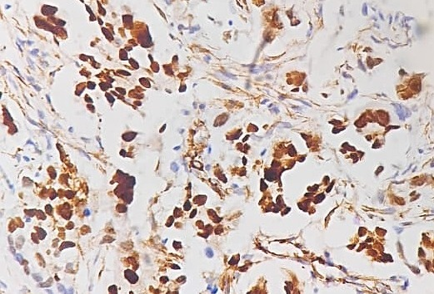
Same Lump, Different Origin
Getting the Diagnosis Right in the Era of Personalised Medicine
Dr. Spoorthy Gurajala, Dr. Lavina Loungani, Dr. Kripa Shettigar
Department of Pathology, Manipal Hospital, Whitefield, Bangalore, India
Background
Personalised cancer care begins with accurate identification of tumour origin. Metastasis to the breast from an extramammary malignancy is rare, accounting for about 0.3% of breast malignancies [1], and ovarian serous carcinoma is among the commonest sources [2,3]. Such metastases can mimic primary breast carcinoma clinically, radiologically and histologically. Hormone receptor status adds to the difficulty [4]. This case shows how targeted immunohistochemistry, biochemical values and imaging revealed a Müllerian primary behind a breast lump, and so directed an appropriate, individualised management pathway.
Histopathological assessment
Breast core biopsy was initially reported as invasive carcinoma of no special type, grade 2 (ER 25% weak, PR 0, HER2 0, Ki-67 65%). Axillary FNAC showed metastatic carcinoma. Given the raised CA-125, GATA3 was performed and was negative. Expedited PET-CT showed adnexal and peritoneal disease with ascites. PAX8 and WT1 were positive with a p53 null pattern, and axillary and inguinal node biopsies were concordant. The final diagnosis was metastatic high-grade serous carcinoma of Müllerian origin, and the patient was planned for platinum-based chemotherapy.
Case presentation
A 75-year-old woman presented with a BI-RADS 5 left retroareolar breast lump and bilateral axillary lymphadenopathy. Serum CA-125 was markedly raised (1887 U/mL), with normal CEA and CA19-9.
Morphology and immunophenotype: breast vs inguinal lymph node
H&E
GATA3
PAX8
WT1
Breast
Inguinal node
Concordant morphology and a GATA3-negative, PAX8-positive, WT1-positive immunophenotype in the breast lesion and inguinal lymph node support metastatic Müllerian serous carcinoma.
Conclusion
Personalised cancer care begins with the correct diagnosis. Neither the site of presentation nor ER positivity establishes tumour origin. In this case, integrated pathological, biochemical and radiological assessment reclassified a presumed breast primary as metastatic Müllerian serous carcinoma and redirected treatment, placing pathology at the heart of precision oncology.
References
1. Lee AHS. The histological diagnosis of metastases to the breast from extramammary malignancies. J Clin Pathol 2007;60:1333–41.
2. Tempfer CB, et al. Metastasis of ovarian cancer to the breast: a report of two cases and a review of the literature. Oncol Lett 2016;11:4008–12.
3. DeLair DF, et al. Non-mammary metastases to the breast and axilla: a study of 85 cases. Mod Pathol 2013;26:343–9.
4. Sieh W, et al. Hormone-receptor expression and ovarian cancer survival. Lancet Oncol 2013;14:853–62.

