Slide 1
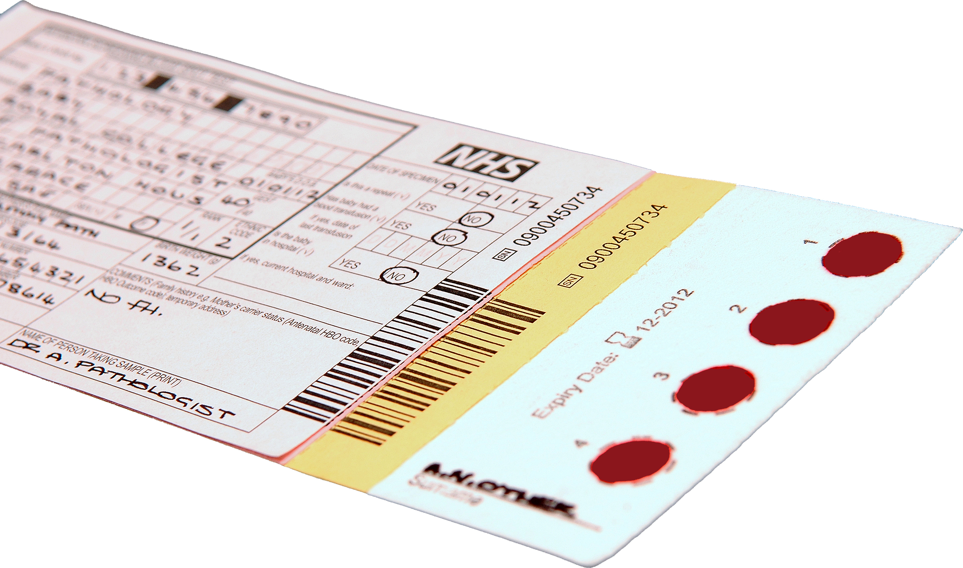
A neonatal blood spot card
Notes:
Activity 2

Slide 2

A couple who have just had a new born child are worried about their child being screened. How would you convince them that screening is important?
Notes:
Activity 2

