Slide 1



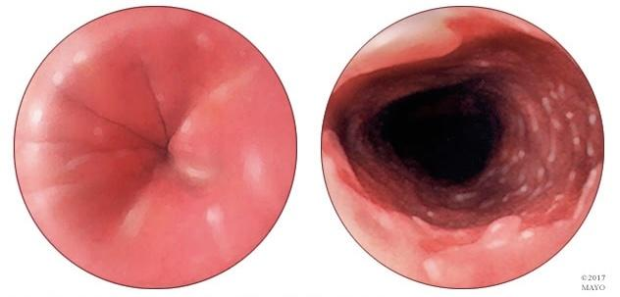
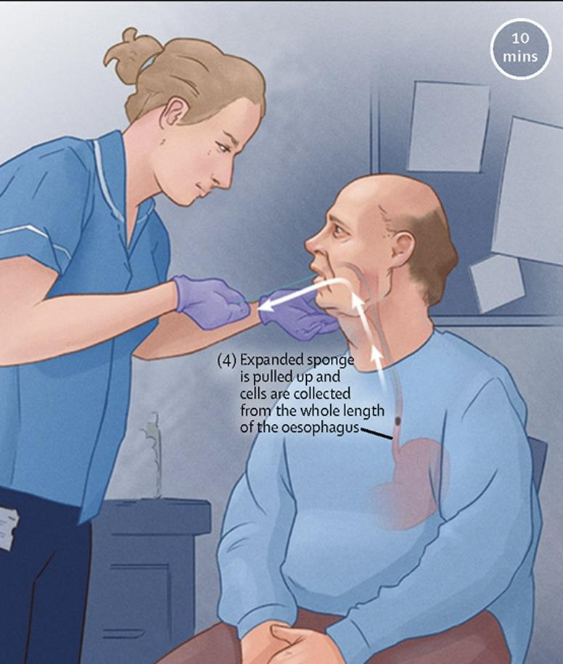
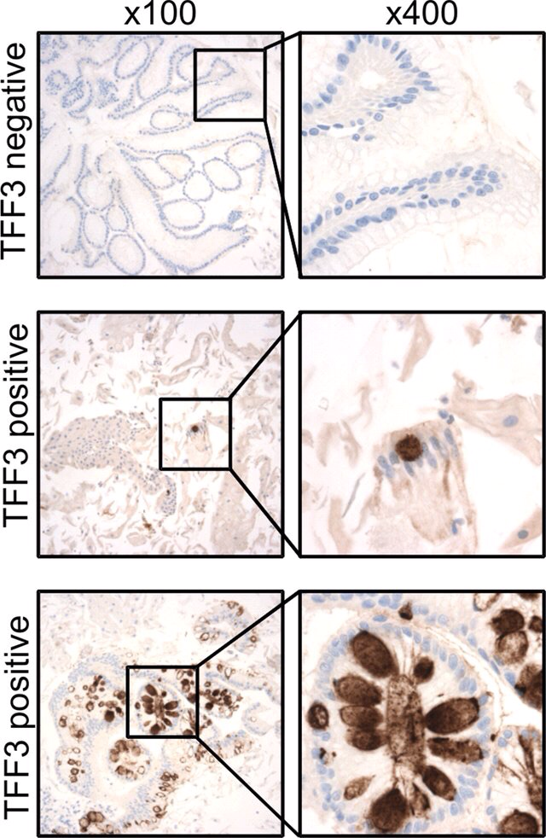
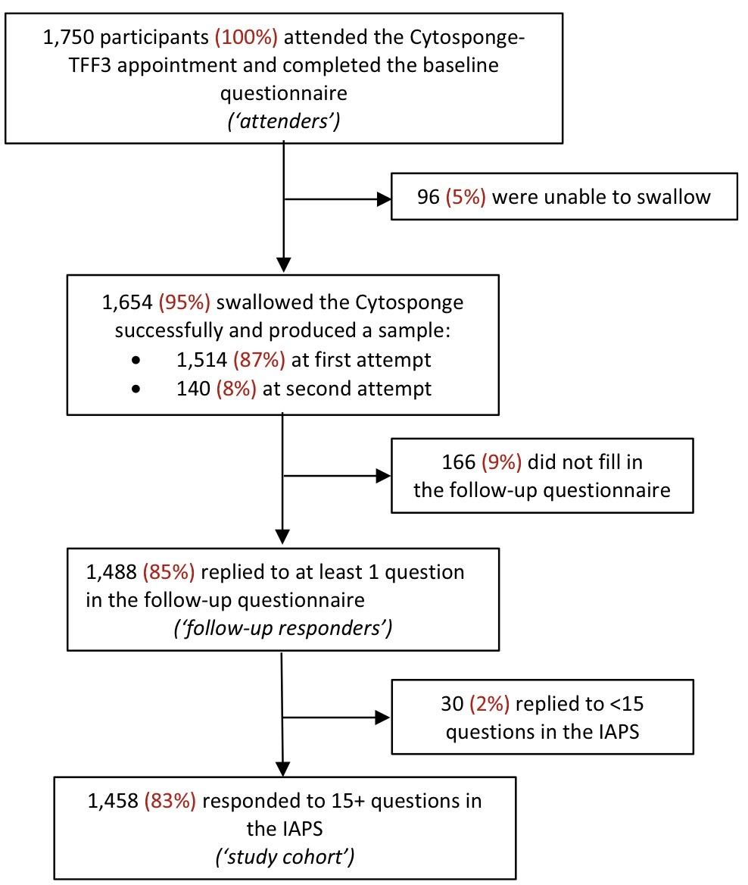
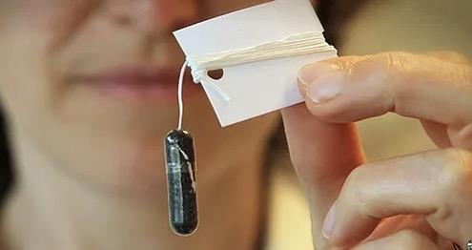
Predicting patient experience of a Cytosponge screening test from the BEST3 trial
Personalised patient care with a capsule-sponge histology test for Barrett’s oesophagus
Charles van Heyningen, patient representative, BEST3 Trial Steering Committee, NIHR, Cambridge
Patient experience of a capsule-sponge histopathology test for early detection of oesophageal cancer
Images:
1. Normal lower oesophagus and Barrett’s oesophagus. 2. cytosponge capsule on string.
3. sample collection by sponge pulled up oesophagus. 4. Immunohistochemistry for TFF3.
5. Flow chart for study cohort selection.
Background:
The capsule-sponge is used to collect cells and with a trefoil factor 3 (TFF3) immunohistochemistry test is used to diagnose Barrett’s oesophagus, a precursor to oesophageal adenocarcinoma.
A randomised controlled trial of the capsule-sponge-TFF3 test showed increased detection of Barrett’s oesophagus. This study reports factors associated with positive and less positive patient experiences
Method:
Patient experience was assessed by the IAPS Satisfaction questionnaire 7–14 days after the test. Patients were selected as shown in the flow chart.
Analysis:
A mean satisfaction score, 11 patient characteristics and one procedure-specific factor were assessed as predictors of the least positive experience..
Results:
The majority of patients (95%) had a positive experience. High anxiety and a failed swallow at the first attempt were strong significant predictors of the least positive patient experience . Additionally, female sex, height, alcohol intake and a higher education level were identified as statistically significant predictors of a lower experience score
Conclusions
This study found that those with high anxiety just before the appointment and with failed swallows at first attempt were more likely to have a negative experience.
Female sex, increased height, alcohol intake and a higher education level predicted a less positive experience.
Identifying anxiety ahead of the procedure and discussing concerns or giving tips to help with swallowing the capsule might make the test more acceptable
References
Ghimire B, Landy R, Maroni R, et al. Predictors of the experience of a Cytosponge test: analysis of patient survey data from the BEST3 trial, BMC Gastroenterology, 2023.
Fitzgerald R, di Pietro M, O'Donovan M et al.Cytosponge-trefoil factor 3 versus usual care to identify Barrett's oesophagus in a primary care setting: a multicentre, pragmatic, randomised controlled trial,The Lancet, 2020,

