Slide 1

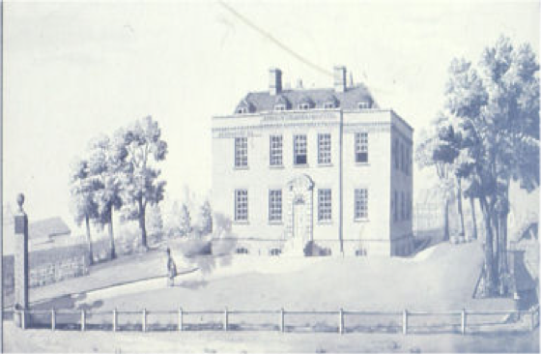
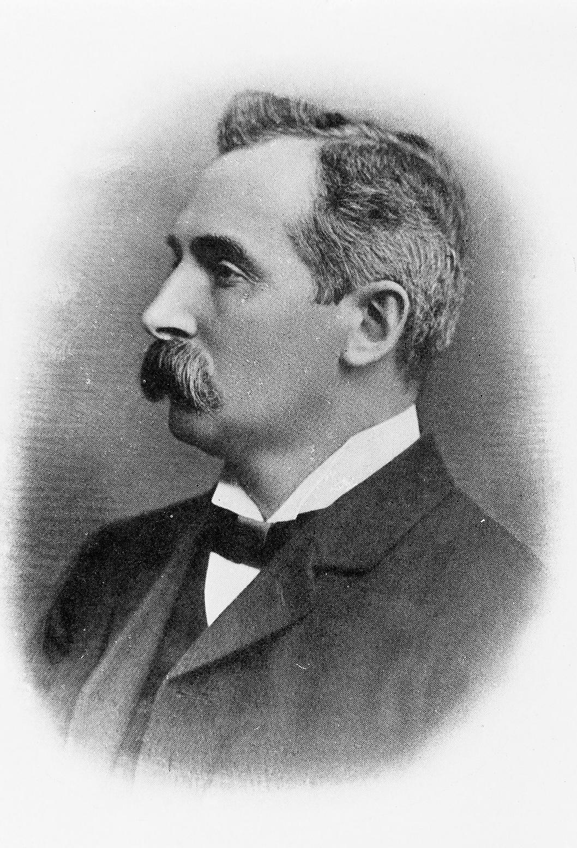
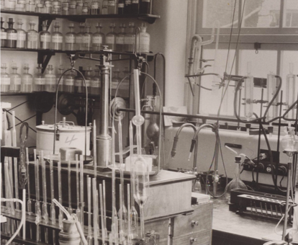
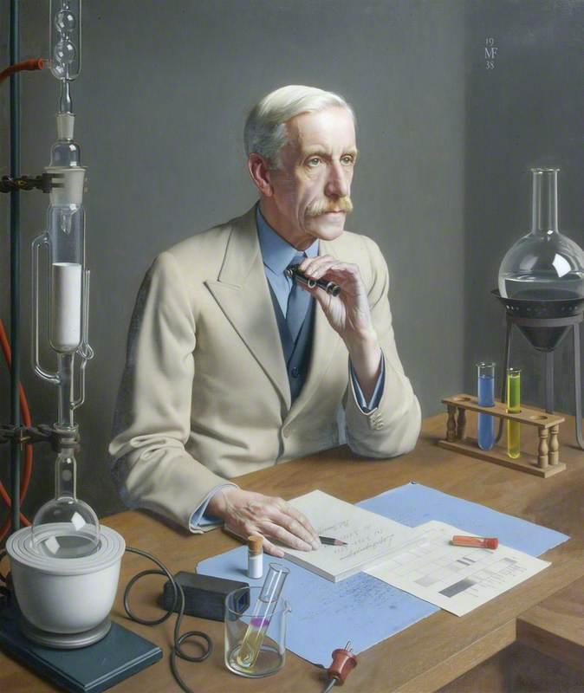
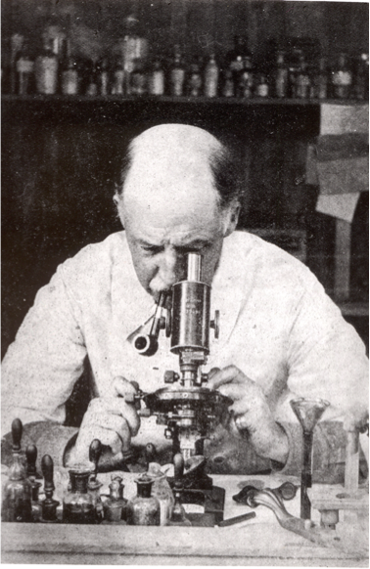
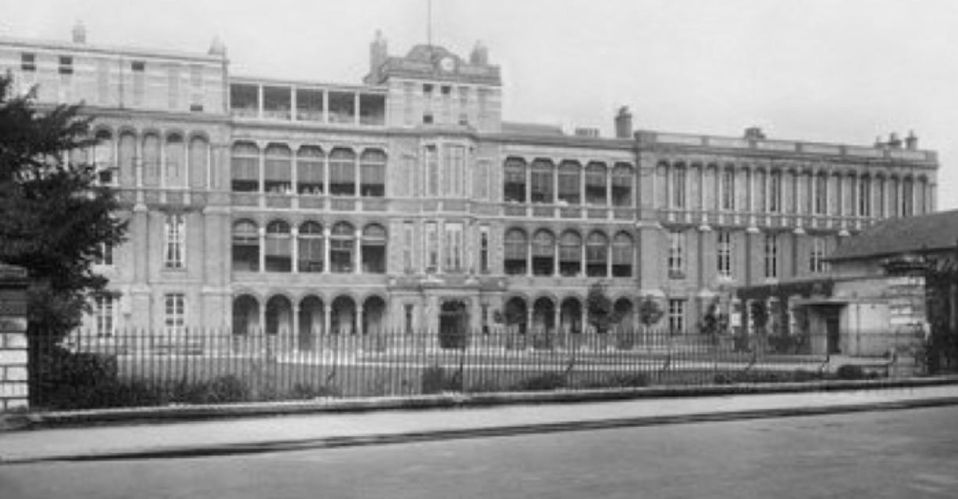
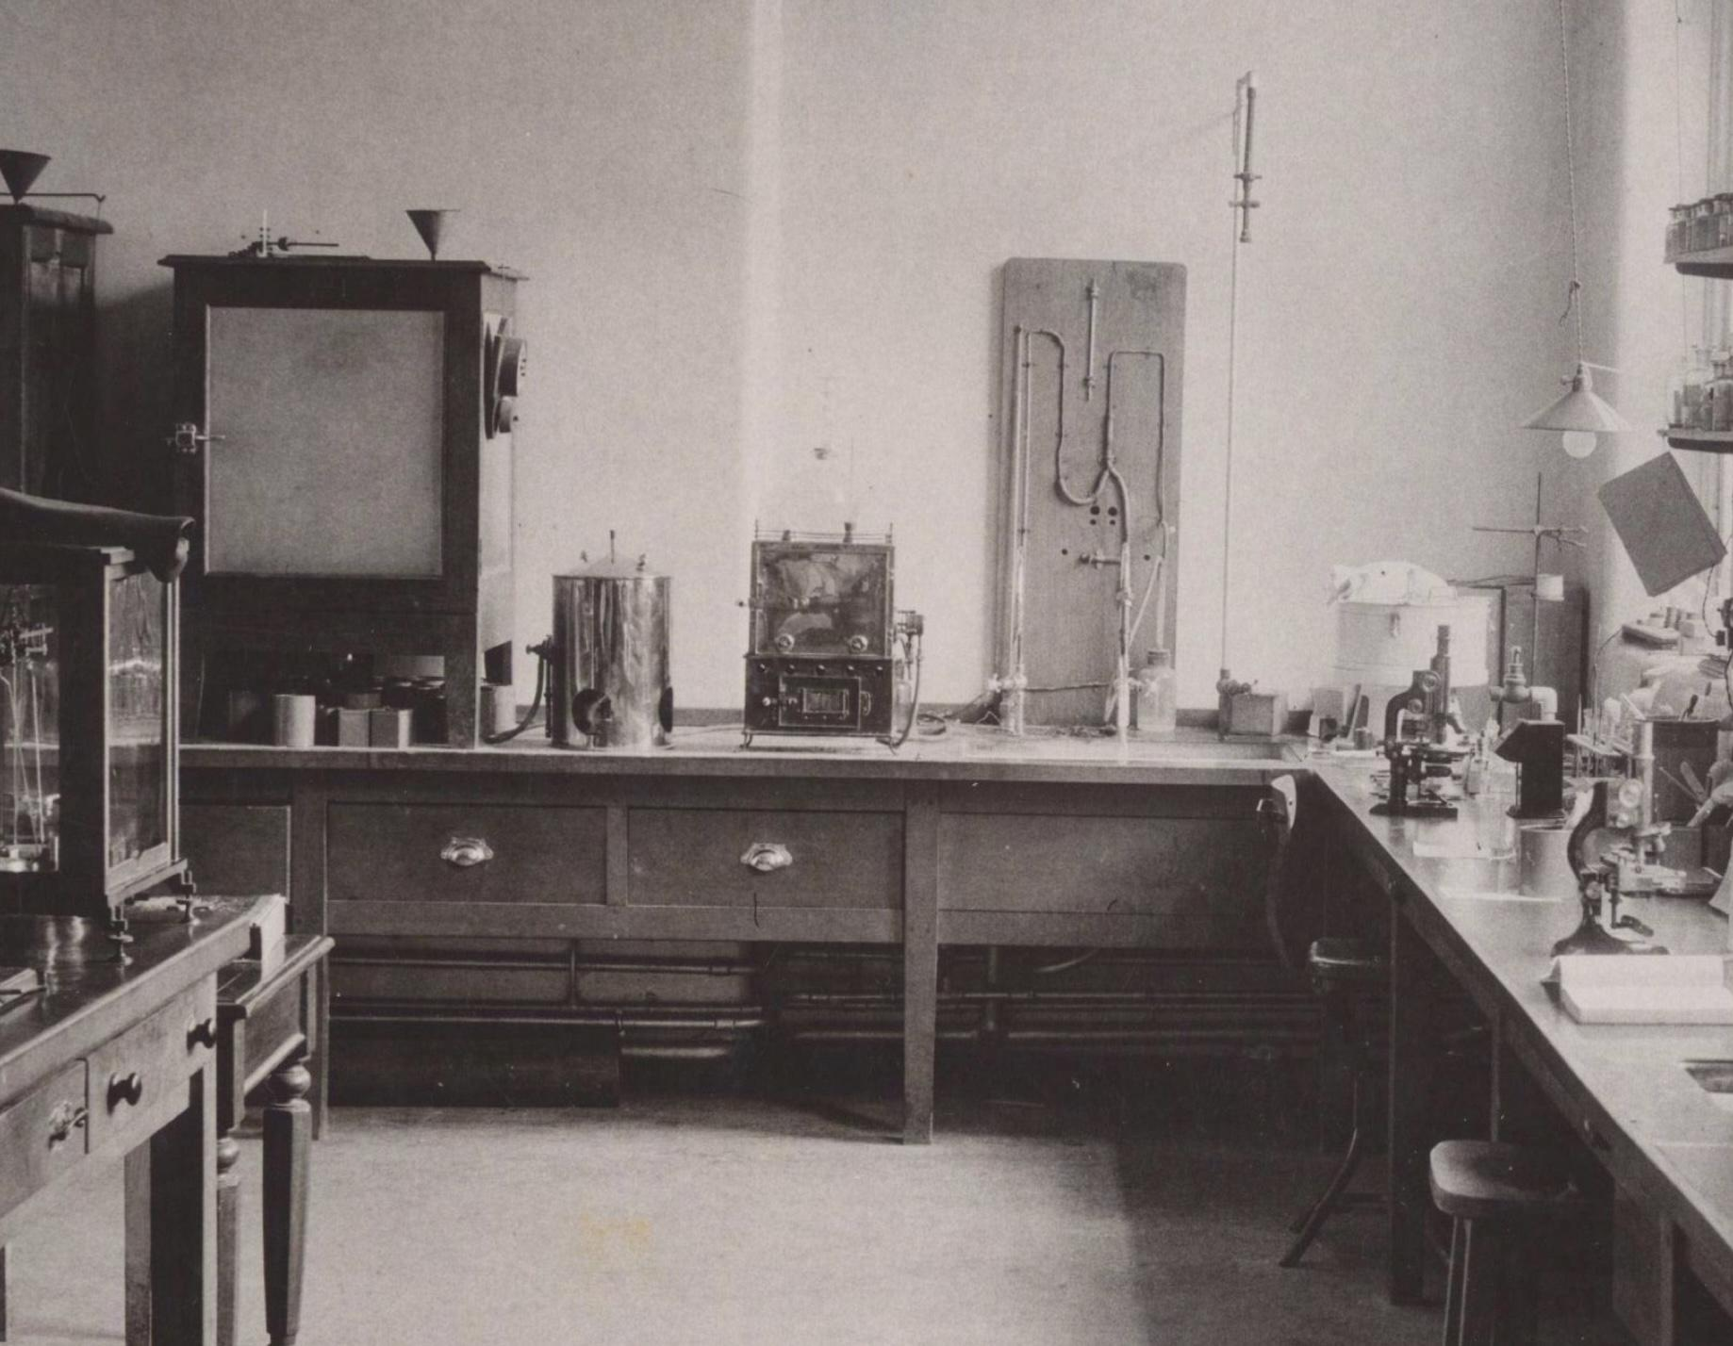
The roots of clinical pathology and biochemistry in Cambridge.
Charles van Heyningen FRCPath.
Aims: To study the origins of clinical pathology and clinical biochemistry in Cambridge, England.
Method: I obtained historical details and images from the University of Cambridge website and Addenbrooke’s hospital archives and literature.
Results: The first professor of pathology at the University of Cambridge was Charles Roy, elected in 1884, who studied the function of the spleen. The first biochemistry professor was Frederick Hopkins, from 1914, who was awarded a Nobel Prize for the discovery of growth stimulating vitamins.
Addenbrooke’s Hospital in Cambridge opened in 1766, was expanded in the 19th century and pathology laboratories were added in 1914. The first clinical pathologist at Addenbrooke‘s Hospital was Walter Malden from 1908. He had qualified as a doctor at St.Bartholomew’s Hospital, was a prolific writer on medical subjects and editor of the journal "Medical World" and attended the hospital for two and a half hours every weekday.
The first honorary clinical biochemist at the hospital was Charles Wolf from 1921 to 1937. He had studied medicine at McGill University in Canada and did research on cystinuria, lactic acid, tumour markers, sperm motility and the Wassermann reaction. Only 70 hospital laboratory biochemical examinations were made in 1921 but this increased rapidly under his influence and by 1937 nearly 2,500 investigations were made involving 10,000 analyses in a year.
Images L to R: The original and expanded (1923) Addenbrooke’s hospital, Professor Charles Roy, painting of Frederick Hopkins working on porphyrin pigments in butterfly wings, Dr. Walter Malden at work, the hospital clinical biochemistry and pathological laboratories in 1937.
Conclusion: Clinical pathologists and biochemists in Cambridge began to influence medical practice in the early 20th century.
Reference: Rook A, Carlton M, Cannon WG. The history of Addenbrooke’s Hospital, Cambridge. Cambridge University Press, 1991, 255-262.

