Slide 1
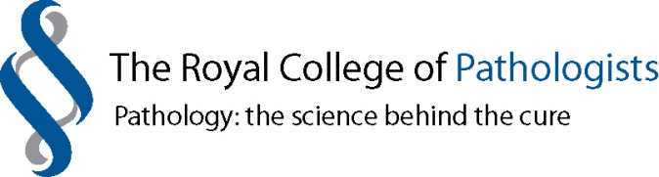
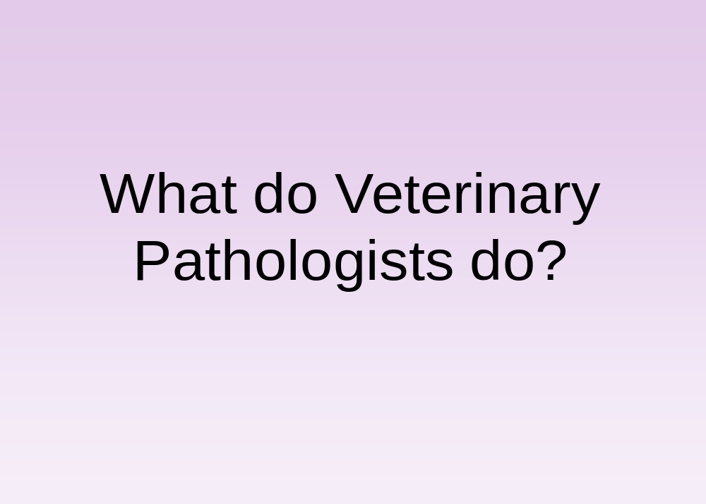
The answer to this question from most members of the public is post mortem examinations (also called necropsies, rather than autopsies, in animals).

Slide 2
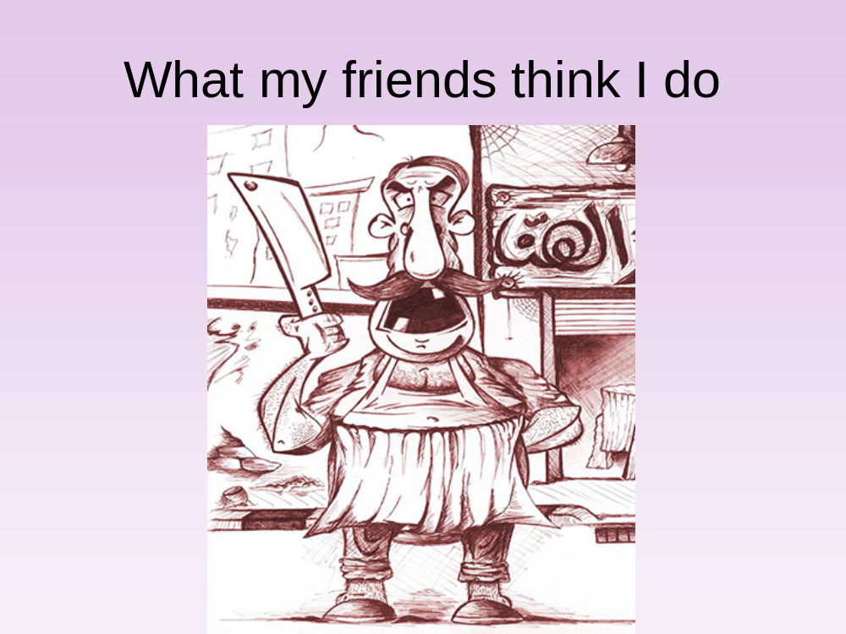
Many people have a mental image of a veterinary pathologist cutting up large animal carcasses. Certainly this is a part of the job; for many pathologists, particularly those within the Animal Health and Veterinary Laboratories Agency (AHVLA) where this is a major part of the job, where they are looking for the cause of disease in production animals, often in large herds and flocks and also monitoring for emerging diseases.

Slide 3
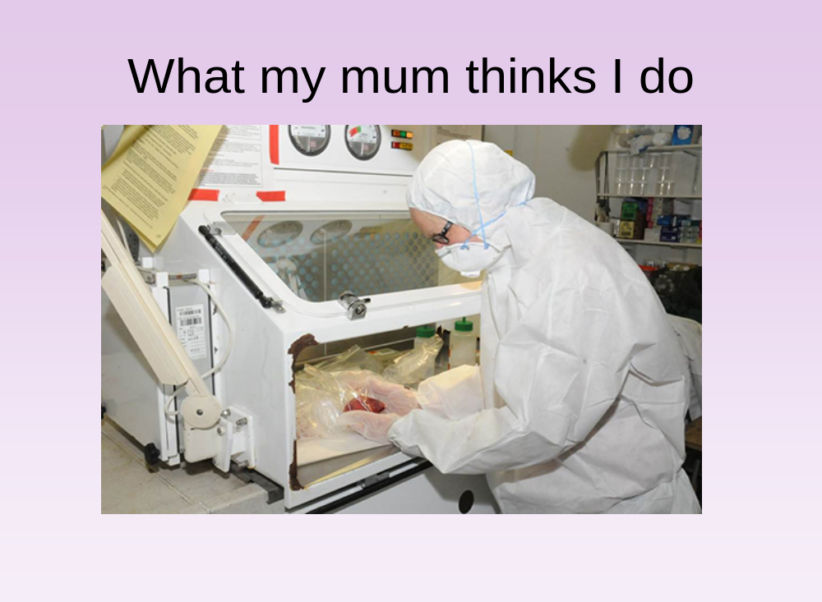
Some of the diseases we deal with are zoonotic and can be transmitted from animal tissues to humans, such as tuberculosis and therefore when handling the tissues from these cases or potential cases we must take extra precautions including the use of safety cabinets and personal protection equipment.

Slide 4
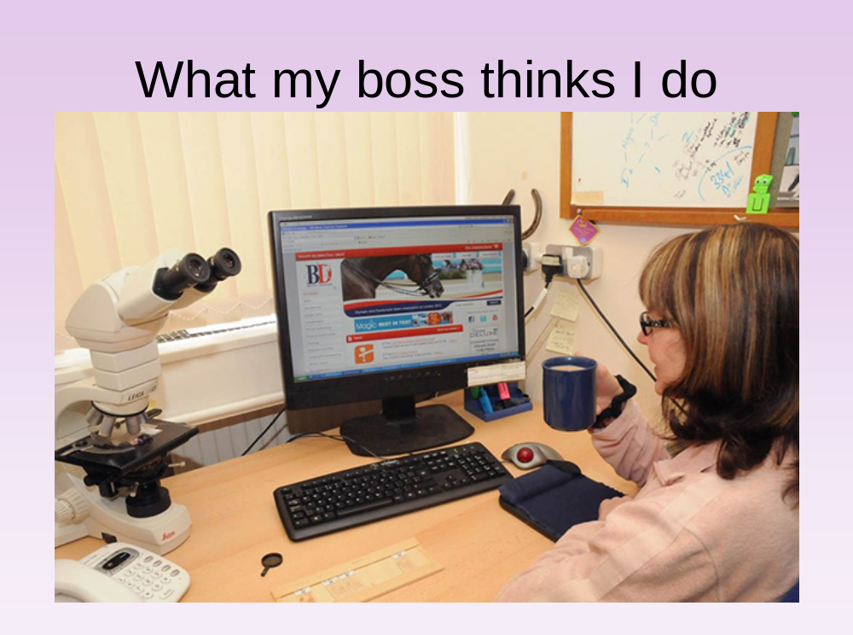
Necessarily, many pathologists will spend time at their desks writing up and researching their cases and contacting submitting vets, although we all need a break sometimes!

Slide 5
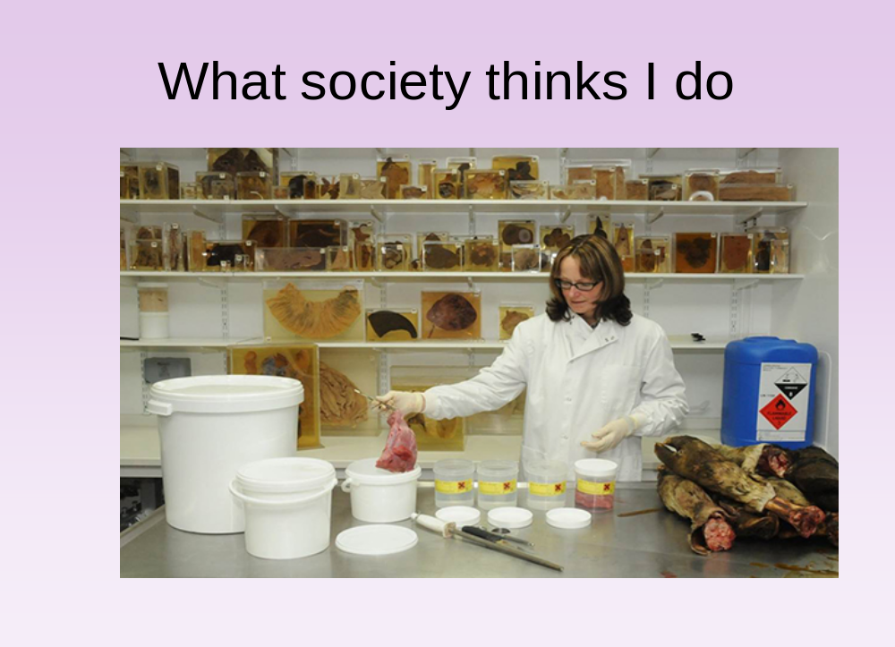
Some people also have an image of pathologists as people who remove tissues and organs and store them. Certainly veterinary pathologists do try to preserve and store tissues from interesting cases, but always with permission from the owner and with respect for the animal, and only for the purposes of training of vets and veterinary pathologists for the future.

Slide 6
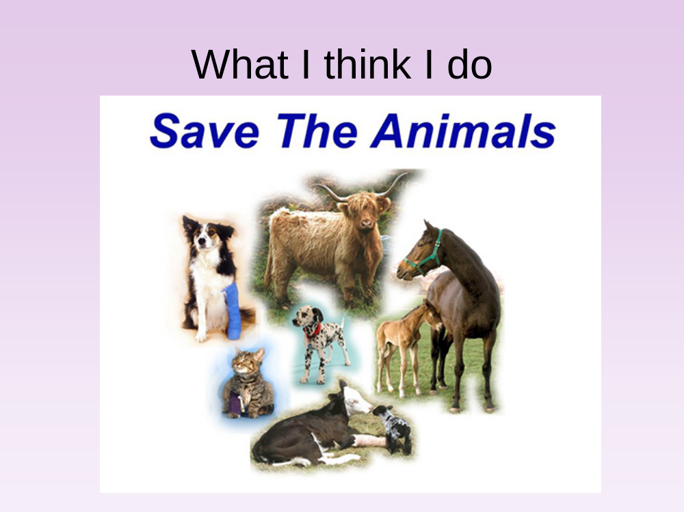
To become a veterinary pathologist you first need to qualify as a veterinary surgeon and undergo additional training. Therefore veterinary pathologists still harbour a desire to ‘save the animals’ whenever possible, even it is not possible for every case, what we learn from one case may help animals in the future.

Slide 7
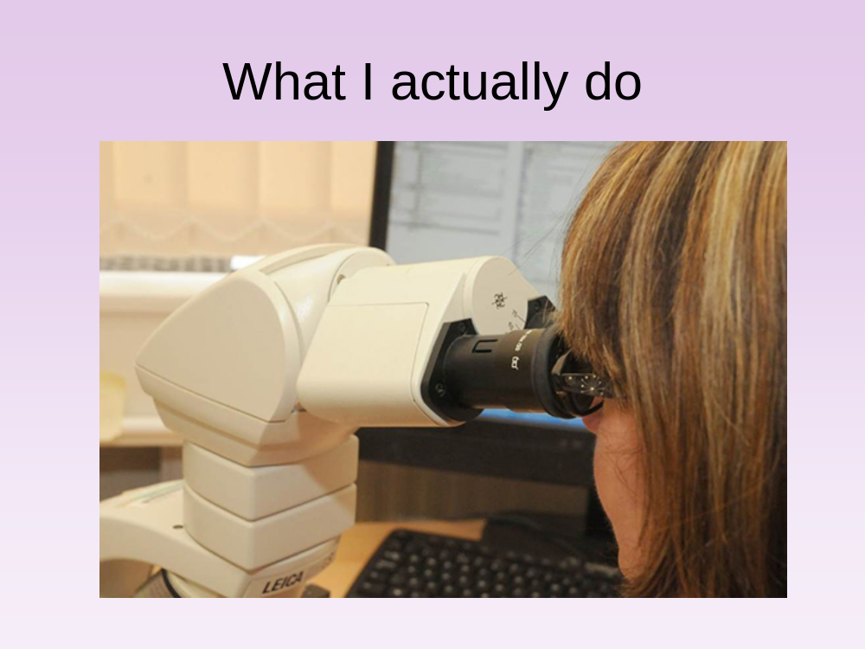
In fact, a large part of my work, and the work of many veterinary pathologists involves looking down the microscope at small sections of tissue that have been removed either at post-mortem examination or have been collected as biopsy specimens by veterinary surgeons in practice, in an attempt to reach the diagnosis and therefore create a treatment and management plan for live animals.

