Slide 1
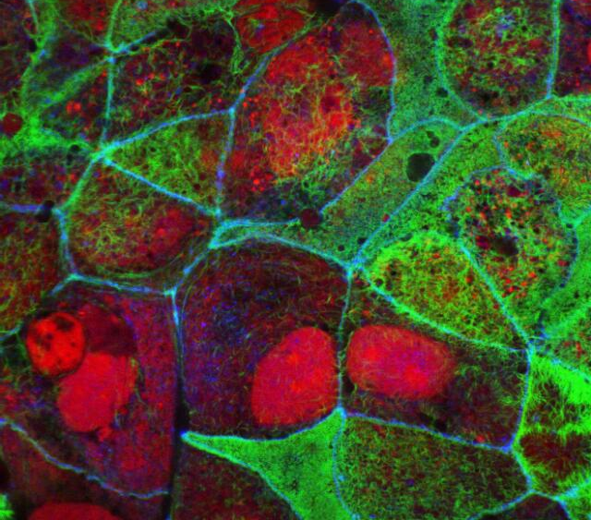
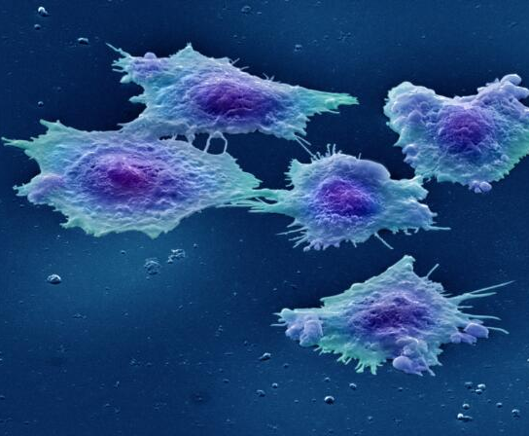
Cells: What can go wrong…
Human colon cancer cells - Annie Cavanagh
Microscope images:
Wellcome - CC BY 4.0
Human colon cancer cell line - S. Schuller

Slide 2
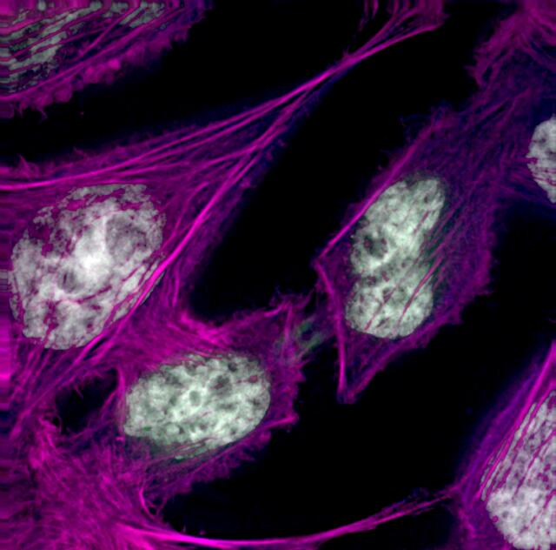
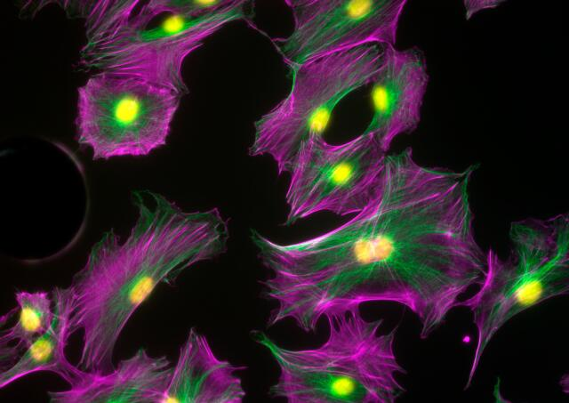
Get inspired: quickly doodle a colourful cell
Osteoblasts - Kevin Mackenzie, University of Aberdeen
Human HeLa cancer cells, cytokinesis - Paul Andrews/Univ. Dundee

Slide 3
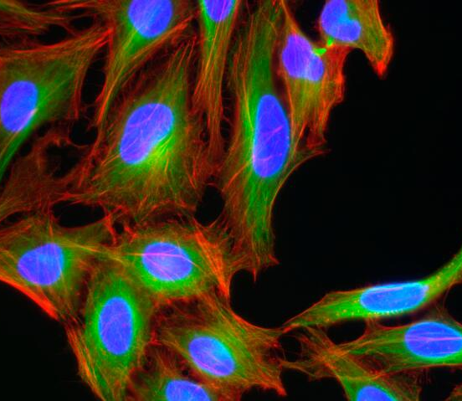
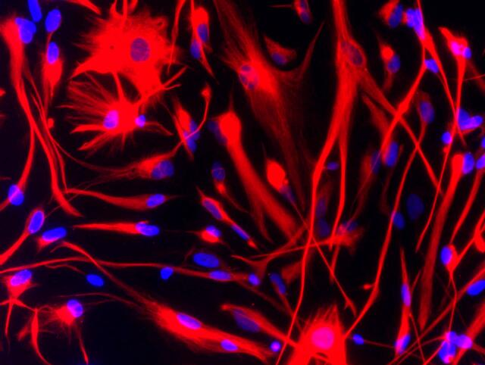
Are these colours found in cells?
Brain cancer stem cells stained for vimentin (red) - Steven Pollard
HeLa cells - Kevin Mackenzie, University of Aberdeen

Slide 4
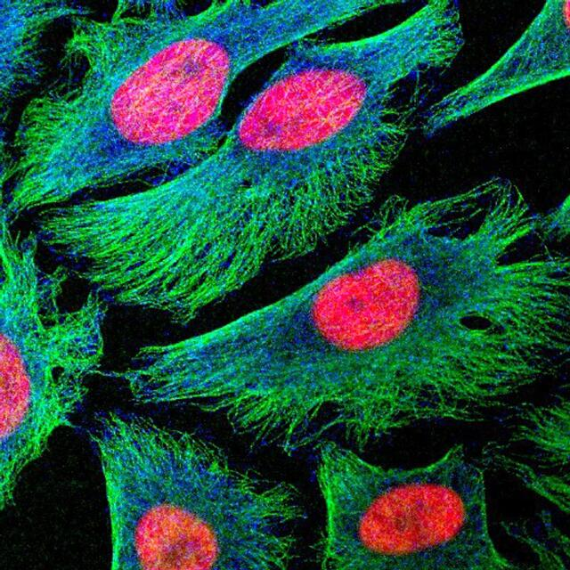
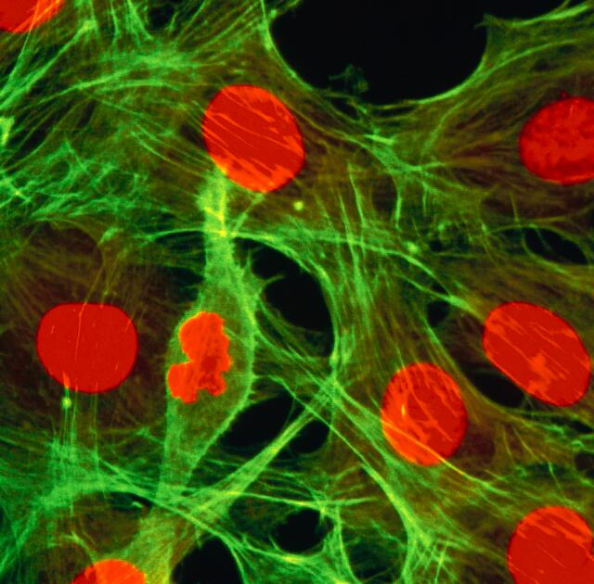
Why might scientists add stains?
Human cancer cells in culture - Matthew Daniels
Dividing fibroblasts showing actin and DNA - Kate Whitley

Slide 5
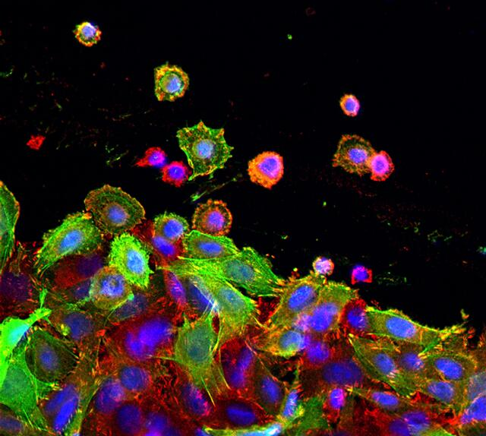
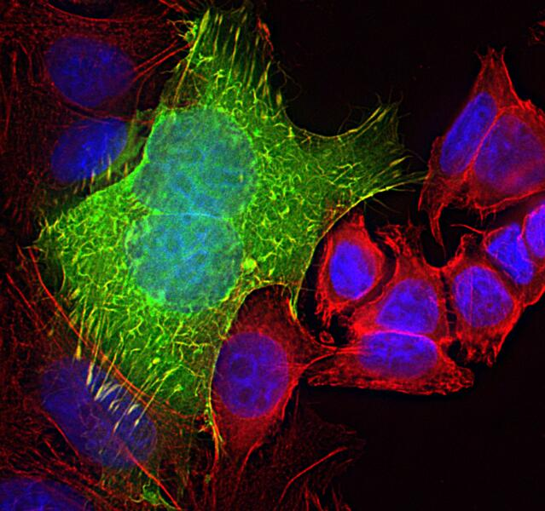
Mutations can allow some cells to grow too well…
They could spread...
Colon cancer cells - Lorna McInroy

Slide 6
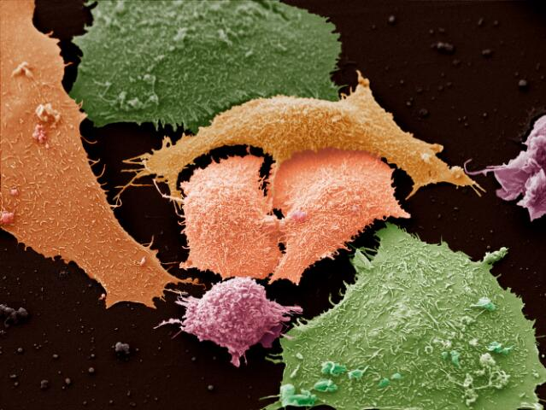
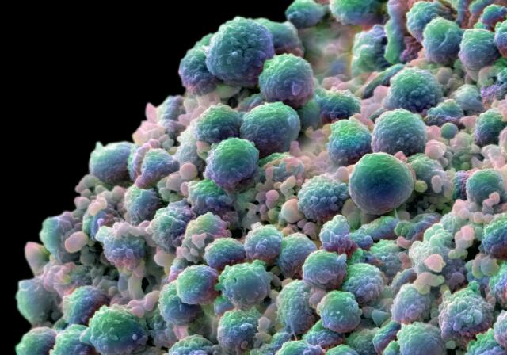
Cancer cells divide quickly and can vary in size
Lung cancer cells - Anne Weston, Francis Crick Institute
Prostate cancer cells - Annie Cavanagh
There are lots of ways to treat cancer: chemicals, radiation and surgery

Slide 7
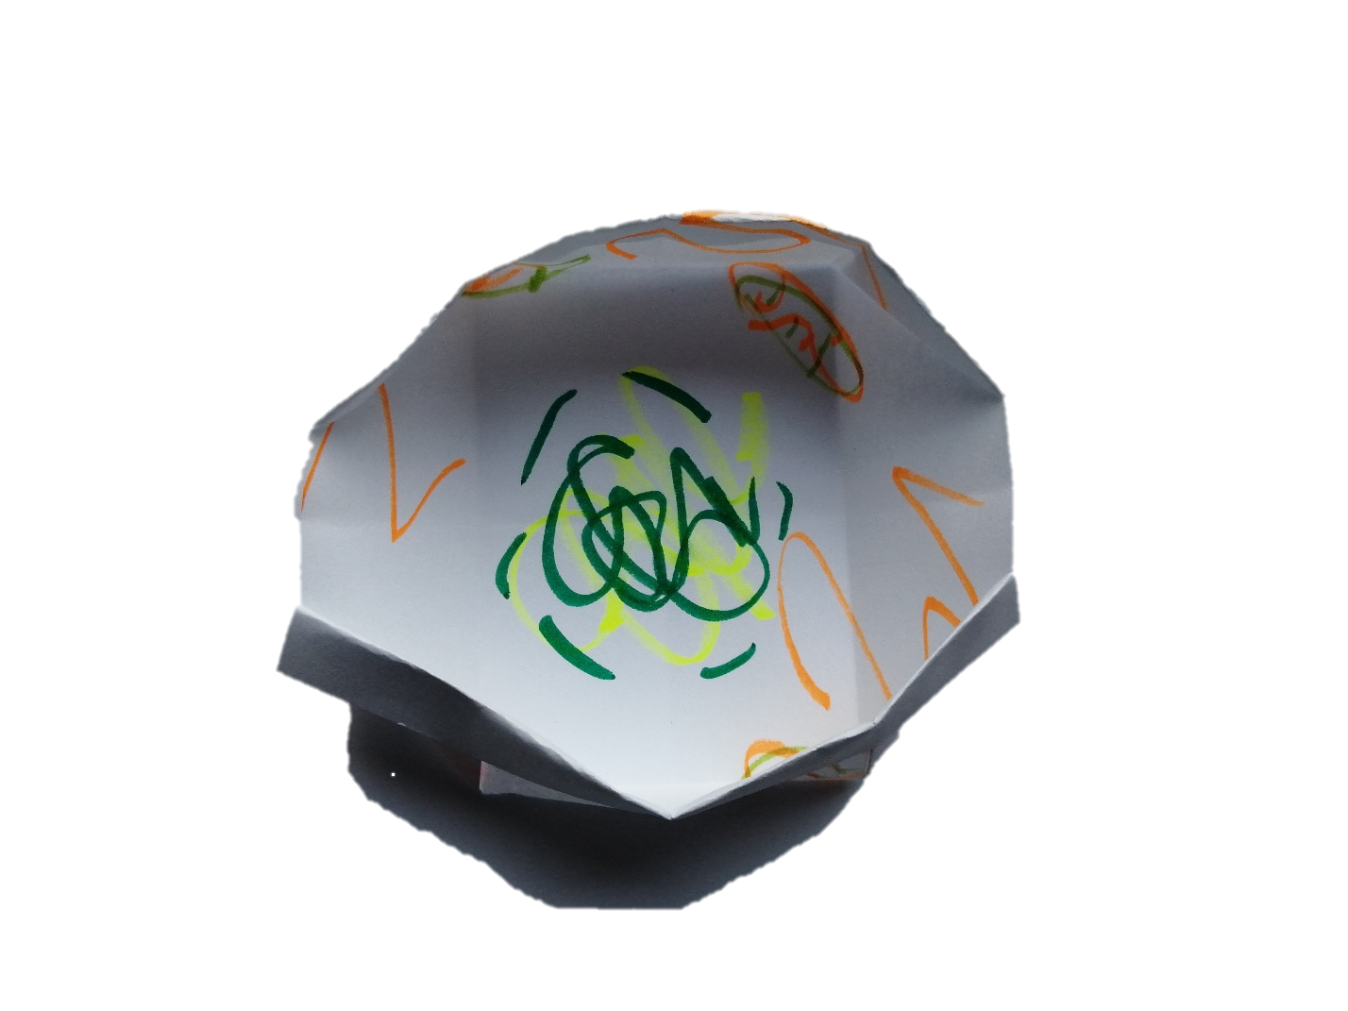
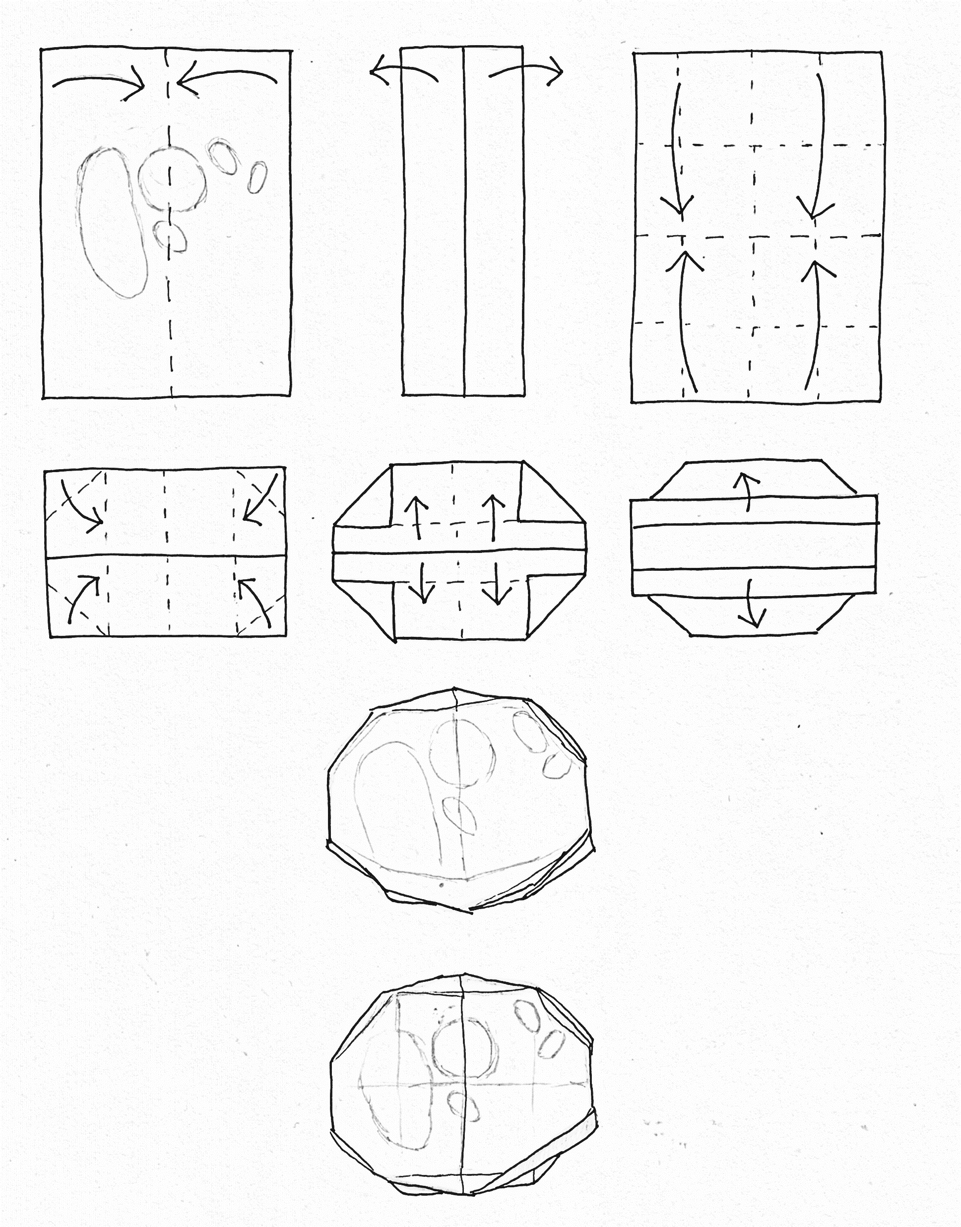
Fold up your colourful cell to become 3D…
© Dr Lizzie Burns 2023
Make lots of cells quickly…

