Slide 1

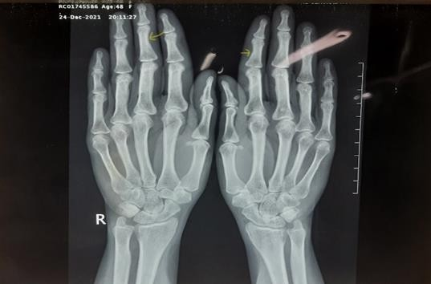
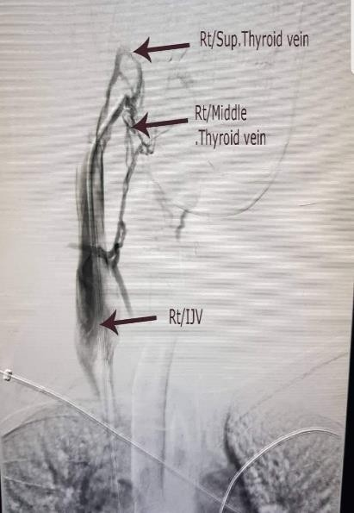
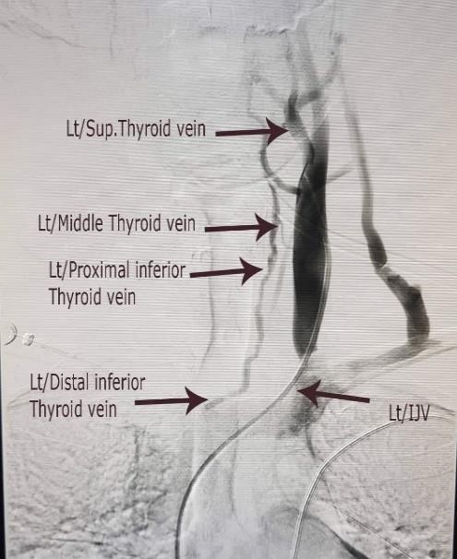
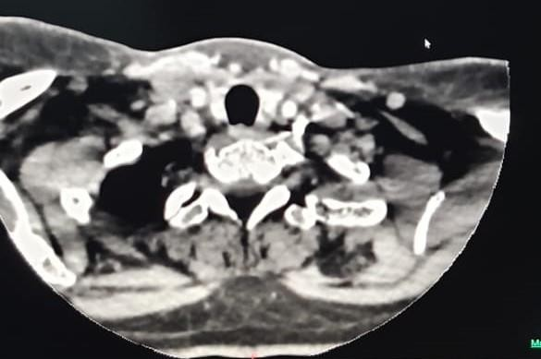
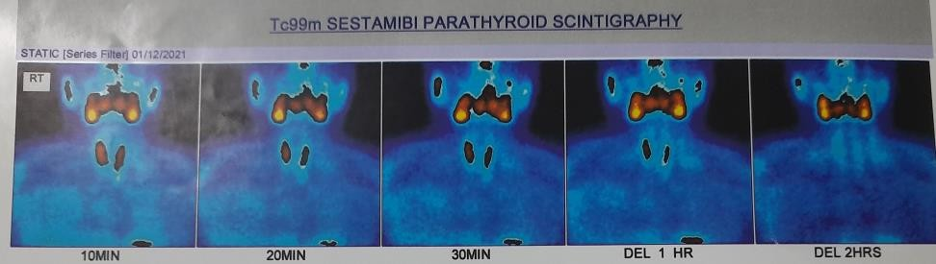
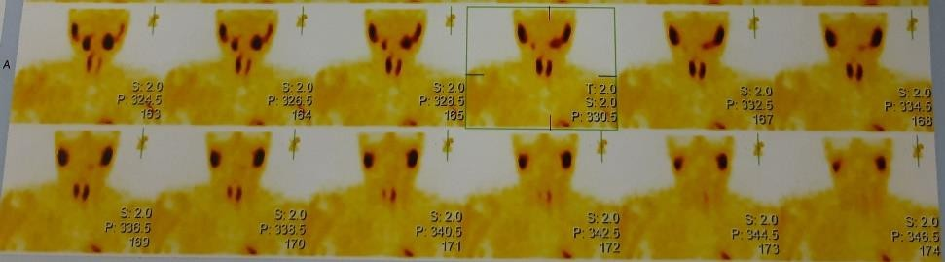
Marvel of parathyroid venous sampling
Thowfeek ZTM¹, Siddiqa OMO¹, Wickramarachchi AW², Katulanda P², Katulanda GW¹
¹Department of Chemical Pathology, National Hospital of Sri Lanka
²University Endocrine Unit, National Hospital of Sri Lanka
zeenath_85@hotmail.com
Introduction
Primary hyperparathyroidism is the uncontrolled production of parathyroid hormone (PTH) resulting in abnormal calcium homeostasis.
It commonly affects females and commonly caused by a solitary gland adenoma.
Case presentation
49-year-old female
Generalized body aches
Fatigue
Laboratory findings
Total calcium | 11.4 mg/dL (8.8-10.2)
Phosphorous | 2.3 mg/dL (2.3-4.7)
iPTH | 177 pg/mL (15-65)
Fractional excretion of calcium | 0.022 (0.01)
Imaging
Figure 1: Subperiosteal resorption along radial aspects of middle phalanges
Site | PTH (pg/mL) | Central/Peripheral Ratio
Rt. Superior thyroid vein | 212 | 1.2
Rt. Middle thyroid vein | 230 | 1.3
Lt. Superior thyroid vein 1 | 179 | 1.0
Lt. Superior thyroid vein 2 | 188 | 1.0
Lt. Middle thyroid vein | 196 | 1.1
Lt. Inferior thyroid vein | 228 | 1.3
C. Inferior thyroid vein | >3000 | 16.6
Femoral vein | 180 | -
Figure 2: 4D CT Neck showing normal parathyroid glands
Table 1: Parathyroid venous sampling – localizing lesion to lower part of thyroid bed. Central: peripheral iPTH 16.6
Intra operative iPTH ( 15 – 65 pg/mL)
Basal | 232
5 min | 212
10 min | 49
Table 2: Intra- operative PTH sampling
Discussion & conclusion
Parathyroid venous sampling is an effective tool in the evaluation of parathyroid adenoma, particularly in the setting of hyperparathyroidism and negative non-invasive imaging.
It is a diagnostic tool that should definitely be considered in the identification of unlocalized adenoma owing to its potential to prevent repeated surgeries.
Figure 3: Tc99 SESTAMIBI Parathyroid Scintigraphy – No evidence of parathyroid adenoma
References:
Taslakian B, Trerotola SO, Sacks B, Oklu R, Deipolyi A. The Essentials of Parathyroid Hormone Venous Sampling. Cardiovasc Intervent Radiol. 2017 Jan;40(1):9–21.
Marcus R. Parathyroid venous sampling: indications, techniques, and outcomes. J Vasc Interv Radiol. 2015 Feb 1;26(2):S176–7.

